Slide 1
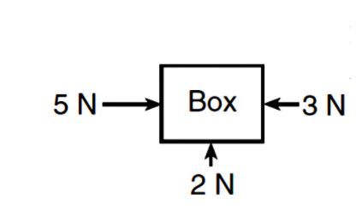
Bell Ringer
Name four kinds of forces and in which direction they point.
Draw the balanced force diagram for the following: A man is pushing a box along a flat surface at constant velocity.
What forces (you can have two) would be needed to balance the following?

Slide 2
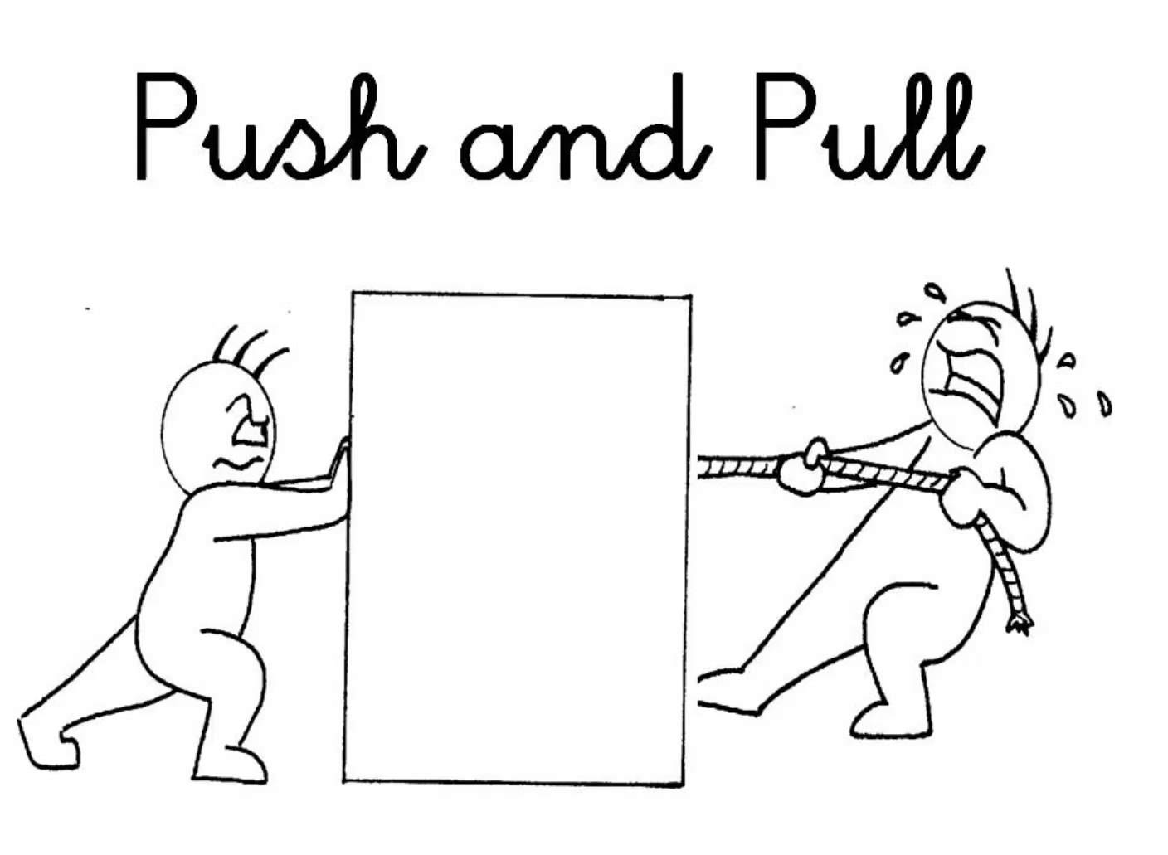
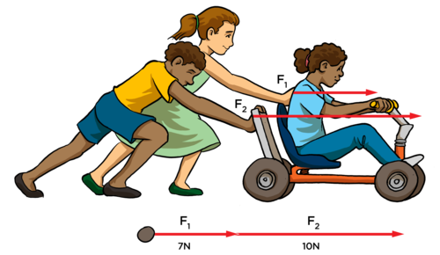

Net Force
Symbol:
$$\sum{F} or F_{net}$$
What is a the Net Force on an object?
It is the sum of all the forces on an object!

Slide 3
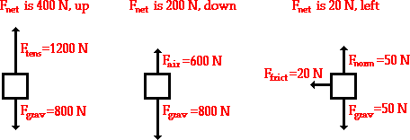
Net Force
Symbol:
$$\sum{F} or F_{net}$$
To find the Net Force you …
Add up all of the forces acting on an object!!!
400 N due North
200 N down
20 N in the negative
direction

Slide 4
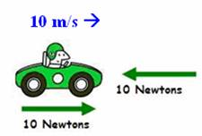
Net Force?
0 Newtons
0 Newtons

Slide 5
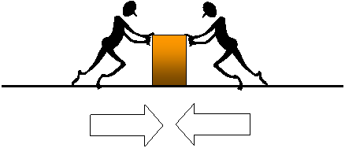
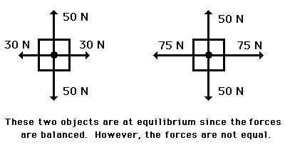
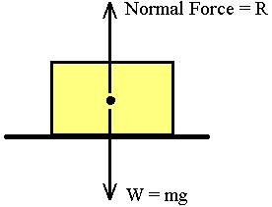
Balanced Forces

Slide 6
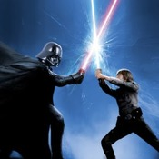
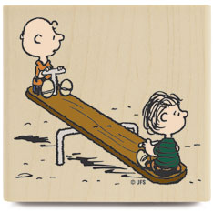
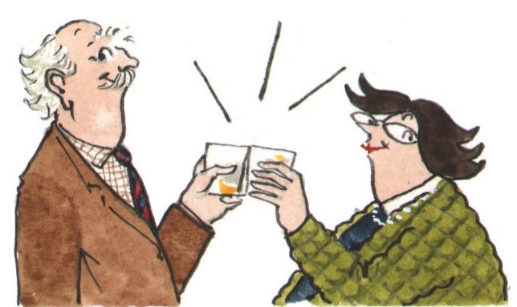
Balanced Forces

Slide 7
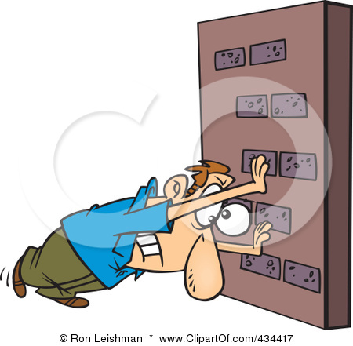
Balanced Forces
How do you know if the forces acting on an object are balanced?
If the object is not moving
If the object is moving at a constant velocity
The Acceleration
=
ZERO

Slide 8
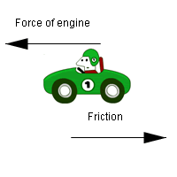
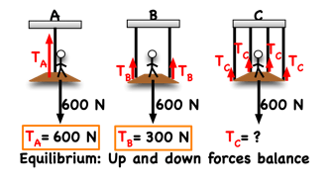
Balanced Forces
When the forces on an object are balanced they will all add up to (net force will be) …
ZERO
In a car, when you speed up to go as fast as you can go, but you can’t go any faster, then the wind and friction are pushing just as hard back at you in the other direction.

Slide 9
Making a Force Balanced
What force would I need to apply to each box so that the forces on them are balanced?
400 N due south
200 N up
20 N in the positive
direction

Slide 10
Balanced forces on a free body diagram
Practice again drawing your force diagram.
http://www.physicsclassroom.com/class/newtlaws/Lesson-2/Drawing-Free-Body-Diagrams

Slide 11
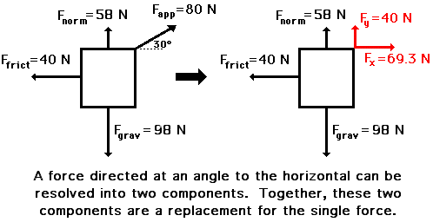
More
difficult
What if there is a force that isn’t just going up or down or left or right?
What if we have a force pointing diagonally?

Slide 12
More
difficult

Slide 13
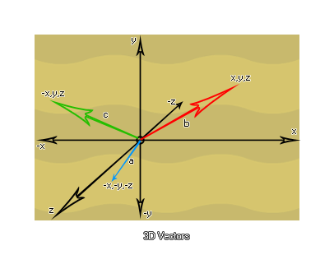
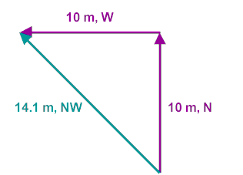
What is a vector?
A vector is a quantity that has both magnitude and direction.

Slide 14
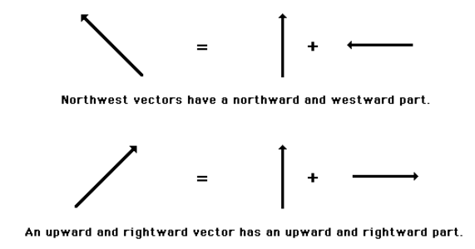
What is a vector component?
In situations in which vectors are directed at angles, a useful mathematical trick is to transform the vector into two parts.
For example, a vector that is directed northwest can be thought of as having two parts - a north part and a west part.

Slide 15
What is a vector component?
Any vector directed in two dimensions can be thought of as having two parts.
Each part of a two-dimensional vector is known as a component.

Slide 16
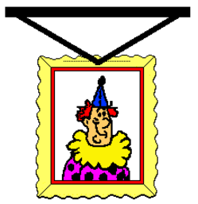
What is a vector component?
Consider a picture that is hung to a wall by two wires.
Each wire exerts a tension force upon the picture to support its weight.

Slide 17
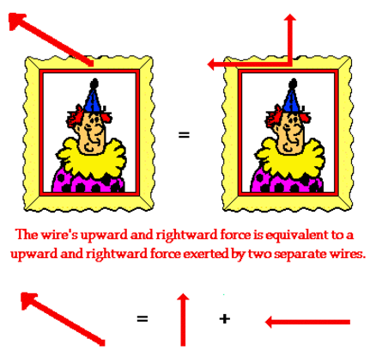
How do you split up your vector into components?
Since each wire is stretched in two directions, both vertically and horizontally, the tension force of each wire has two components, a vertical and a horizontal component.

Slide 18
How do you split up your vector into components?

Slide 19
How do you split up your vector into components?

Slide 20
How do you draw your components on your force diagram?
X components
Y components

Slide 21
Balanced Force Equations
When the forces on an object are balanced we will write two equations to describe what is going on.
Vertical:
UP Forces = Down Forces
Horizontal:
Left Forces = Right Forces

Slide 22
How to Deal with Balanced Force Equations?
Draw A Force Diagram!!!!!!!!
Separate everything into X and Y directions
Right Forces = Left Forces
Up Forces = Down Forces

Slide 23
Balanced Force Equations
Here’s an example of what that would look like.
N
Vertical:
UP Forces = Down Forces
Horizontal:
Left Forces = Right Forces
Ff
Fp
Fg

Slide 24
How to Deal with Balanced Force Equations?
Draw A Force Diagram!!!!!!!!
Separate everything into X and Y directions
Right Forces = Left Forces
Up Forces = Down Forces

Slide 25
What is the weight of the box?
How much is the Normal Force?
How much friction is there acting on the box if it is moving at a constant velocity?
25 N
15 kg
rough surface

Slide 26
What is the weight of the box?
How much is the Normal Force?
How much friction is there acting on the box if it is moving at a constant velocity?
25 N
15 kg
Force Diagram
rough surface
N
Ff
Fp
What is weight?
The Force of Gravity!!!!
W
$$F_{g}=W=mg$$
W = (15)(10) = 150 N
Is the block accelerating in either the x or y direction?
No because the velocity is constant!
With the forces balanced we know that :
Left = Right
Up = Down
Ff = 25 N
N = 150 N

Slide 27
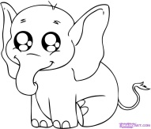
Jimmy is attempting to tow his new baby elephant to the circus. The elephant is not moving...
300 N
What is Normal Force and the Force of Friction?
158 kg
$$73°$$
N
T
300*sin(73)
= 287 N
X
Left = Right
Y
Up = Down
Ff
300*cos(73)
= 88 N
Ff = 88 N
N + 287 = 1580 N
N = 1580 – 287
= 1293 N
W
= 1580 N

Slide 28
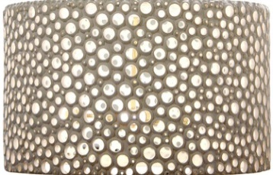
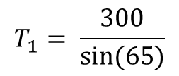
T1
$$65°$$
T2
30 kg
Jane is hanging a chandelier from her ceiling and needs to know how much tension is in each cable?
X
Y
T1
T1*cos(65) = T2
T1*sin(65) = W
T1*sin(65)
331*cos(65) = T2
T1*sin(65) = 300
T2
T1*cos(65)
$$T_{1}= \frac{300}{sin⁡(65)}$$
$$T_{2}=140 N$$
$$T_{1}=331 N$$
W

Slide 29
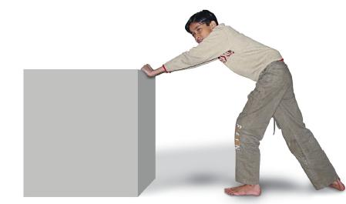
You are pushing a box, weighing 7kg downward at an angle of 15 degrees with a force of 15 Newtons. If the box is moving at a constant velocity, what is the normal force acting on the box? Force of friction?

Slide 30
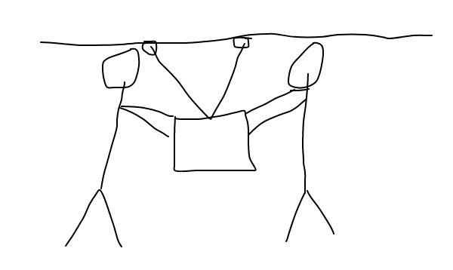
You and a friend are both pushing downward with a force of 20 Newtons at an angle of 20 degrees on a 15 kg box that is suspended by two ropes. If the box is not moving, what is the tension in each rope?

