Slide 1
Bell Ringer
A cyclist goes around a circular track with a diameter of 60m:
After 3 minutes he has gone around 5 complete times. What is his average speed? Average velocity?
After 5 minutes he has gone around 7.5 times. What is his average speed? Average velocity?
50m

Slide 2
Science Matters
Lightning

Slide 3
Lightning never strikes the same place twice?

Slide 4
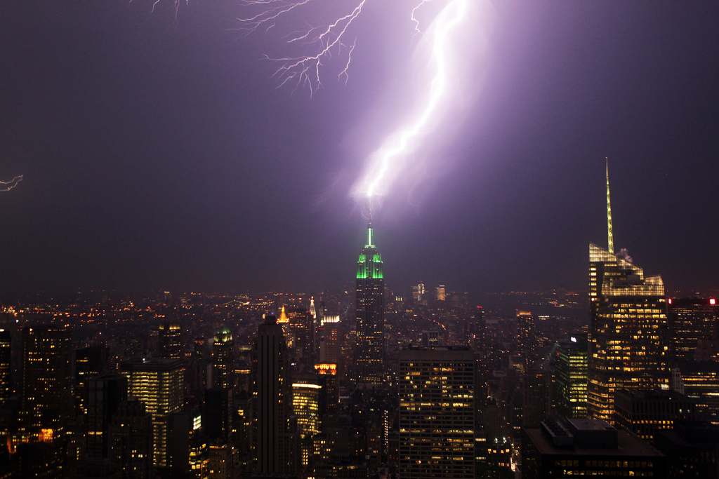
FALSE!
Empire State Building struck about 25 times a year
One park ranger was struck seven times by lightning, and still lived
Lightning strikes taller objects, especially ones that conduct electricity, more often

Slide 5
What to do?
If you are in a car, stay inside of it! It’s actually one of the safer places to be in a lightning storm.
If you are outside, find low ground.
DO NOT lay down. You want as little contact with the ground as possible because lightning spreads across the ground.
DO crouch down on the balls of your feet.
Find shelter inside if you are close.

Slide 6
On your white boards, with your group, draw these graphs.
I’ll pick on a table to bring up their velocity graph for each of the examples, so keep them all on your board.

Slide 7
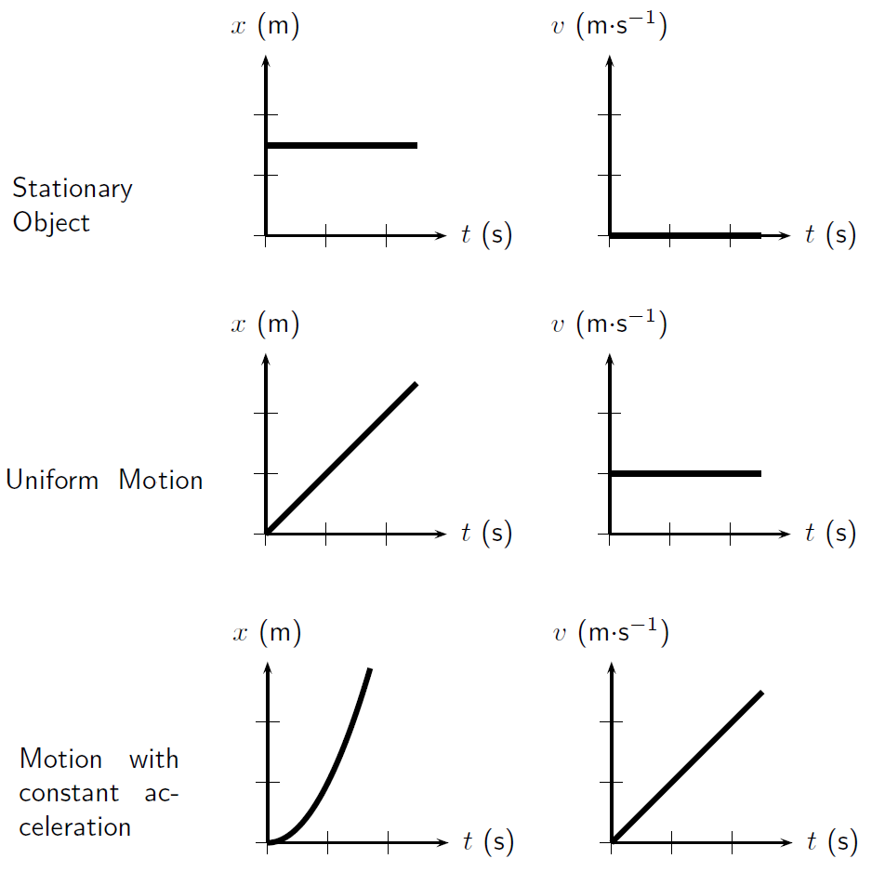

Slide 8
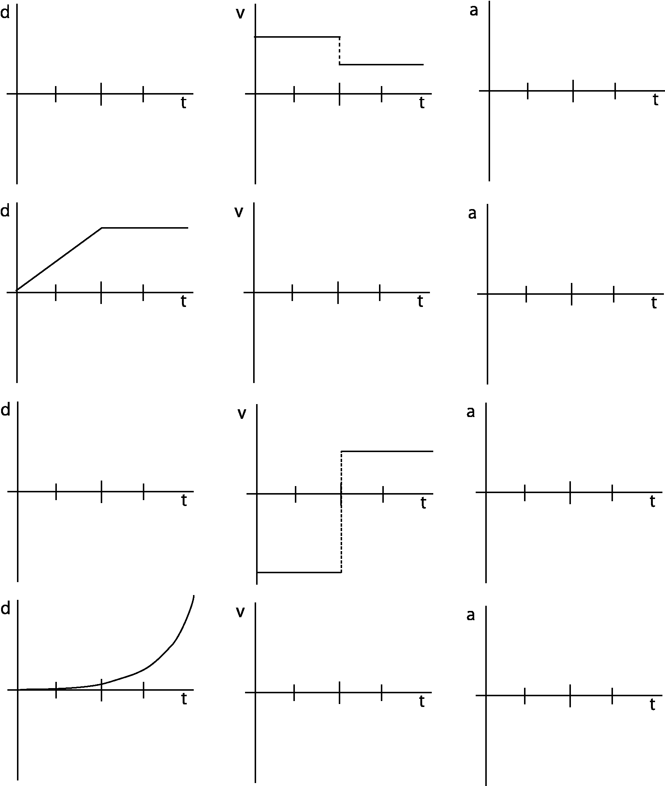

Slide 9
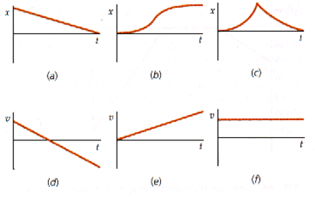

Slide 10
Practice
Draw the Velocity vs. Time graph and the Position vs. Time graph if your velocity follows these patterns:
Assume you start at x = 0m
t = 0 – 5s t = 5 – 10s t = 10 – 15s v = -4 m/s v = 2 m/s v = 3 m/s
x = -20 m
x = 10 m
x = 15 m
+
+
x (m)
V (m/s)
x = -10 m
x = 5 m
5 m
t (s)
t (s)

Slide 11
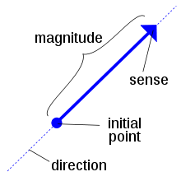
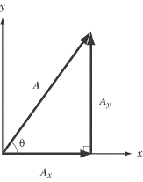
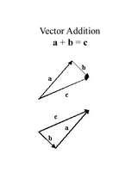
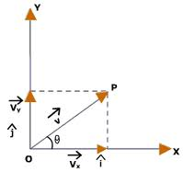
Vector Mechanics

Slide 12
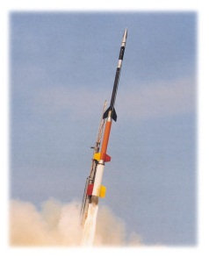
Basic Addition and Subtraction
This is far from rocket science, but without it we could never launch rockets!
+
=
5 m
3 m
8 m
-
=
5 m
3 m
2 m
* a negative sign means to flip the vector!
+
=
5 m
3 m
2 m

Slide 13
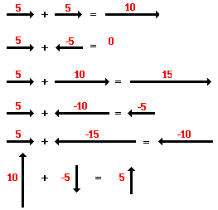
Practice
?
?
?
?
?
?

Slide 14
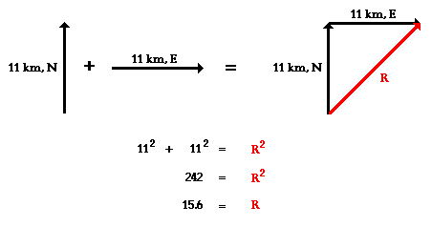

Slide 15
The Resultant Vector

Slide 16
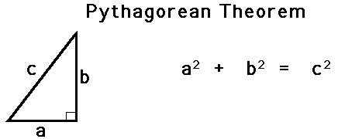

Slide 17
Practice
6m
+
6m
=
8.48m
10m
+
3m
=
10.44m
4m
+
7m
=
8.06m

Slide 18
Break

Slide 19
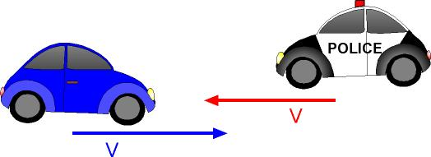
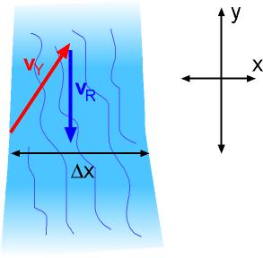
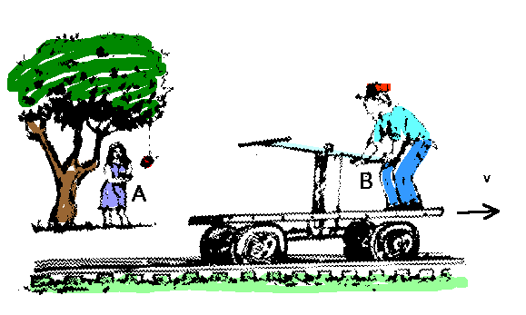
Relative Motion

Slide 20
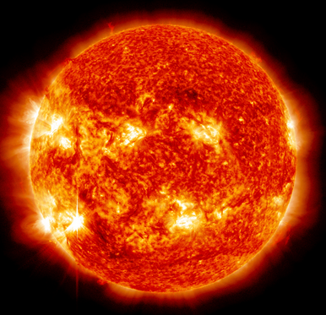
Relative Motion
Are we moving?
One of the most important thing about trying to solve a problem is choosing the correct
FRAME OF REFERENCE. Everything changes based on the frame of reference you choose.
Relative to the Classroom…..NO!
Relative to the Sun……YES!!!

Slide 22
FRAME OF REFERENCE
A frame of reference is what you are comparing your results with.
For example, if we use the inside of the airplane as our frame of reference, then the orange juice fell straight down.
But if we use the surface of the Earth as our frame of reference then the orange juice is moving forward 200 miles per hour.

Slide 23
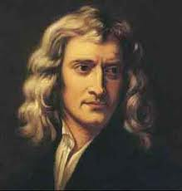
NEWTONIAN FRAME OF REFERENCE
Sir Isaac Newton said that any frame of reference is “valid” as long as it (the reference frame) is not accelerating. If you are inside a Newtonian Frame of Reference then all the laws of physics will appear to be obeyed and everything will act “normal”.

Slide 24
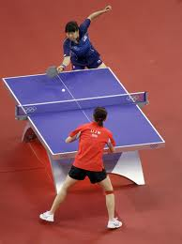
The PING PONG Question
If you could play a normal game of ping pong inside of your frame of reference, then it is a “valid” Newtonian Frame of Reference.

Slide 25
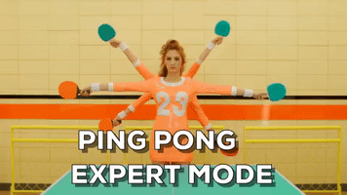
Am I Valid?
I am in an airplane moving 200 miles per hour?
Can I still play ping pong?
YES. As long as the plane doesn’t speed up, slow down, or turn, then it is a valid frame of reference. If you are inside the plane everything will obey the laws of physics. You could play a game of ping pong and nothing “strange” would happen.

Slide 26
Am I valid?
I am in the back of a semi-truck driving around a circular race track?
NO! Turning counts as acceleration. If you tried to play ping pong in the back of the truck “weird” stuff would happen. The ball would keep veering towards the outside wall of the truck even if you didn’t hit it that direction.

Slide 27
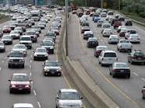
RELATIVITY
If a measurement changes depending on your point of view, then we say it is “RELATIVE”.
For example, how fast the car next to you on the freeway appears to be moving depends on how fast YOU yourself are moving. If you match speeds they “appear” to be parked next to you.

Slide 28
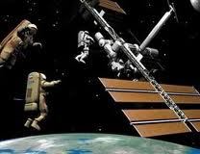
RELATIVITY
If a measurement changes depending on your point of view, then we say it is “RELATIVE”.
When NASA repairs satellites they first have to find the satellite and then match its speed. The astronaut doing the repairs is actually hurtling through space hundreds of miles an hour. But the satellite “appears” to hold still because the astronaut is moving with it.

Slide 29
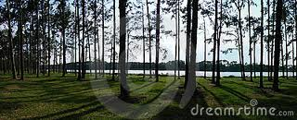
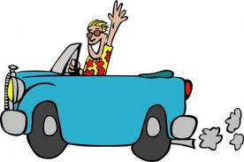
RELATIVITY
In old movies it was the SCENERY that moved and not the cars. Easier to film that way. Your brain can’t tell the difference.
Focus hard and only Look at the trees,
Then look only at the car
Notes:
Focus hard and only Look at the trees,
Now look at the car

Slide 30
RELATIVITY
So far this year we have learned two important values that are “relative”.
POSITION and VELOCITY:
Where is the orange juice now? And where is it going next? The Stewardess might say the position is not changing because it stays inside the glass. Someone on the ground might say the position is changing quickly as the cup shoots forward across the sky. Both are right.

Slide 31
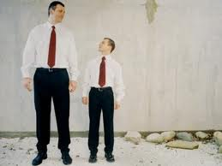
POINT OF VIEW
Our own personal bias must be taken into account whenever we measure something. We call this bias our “Point of View”.
For example, when tall people walk down the hall everyone appears to be small and low. When short people walk down the hall everyone appears to be tall and big. It just depends on your POINT OF VIEW!!

Slide 32
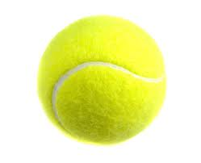
POINT OF VIEW
Imagine that you are walking down the hall throwing a tennis ball up and then catching it. Let’s look at what is happening in more detail.

Slide 33
MY POINT OF VIEW
You will see the ball leave your hand going straight up and then fall back down into your hand coming straight down. As long as you walk at a constant speed nothing “strange” should happen.

Slide 34
OTHERS POINT OF VIEW
The tennis ball moves forward with you in a parabolic arc.

Slide 35
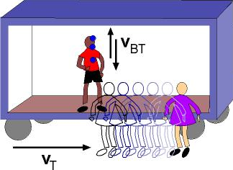
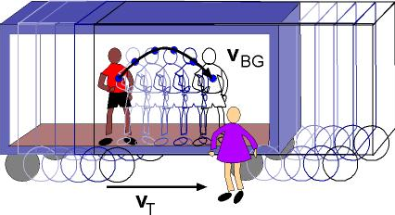
Relative Motion
You are standing on a train cart and are throwing a ball up and down.
What would the motion of the ball look like to the other passengers?
What would the motion of the ball look like for someone on the side of the road?
Normal Free Fall
Projectile Motion!!!

Slide 36
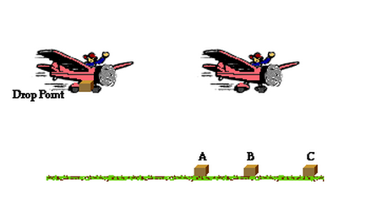
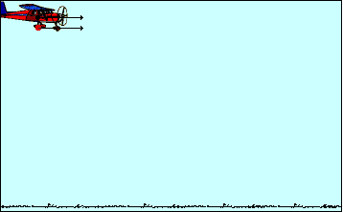
Relative Motion
You are dropping a package out of a plane, where will the package land relative to the plane?
How does the package move relative to the plane?
How does the package move relative to an observer on the ground?

Slide 37
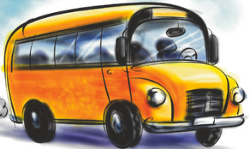
Frame of Reference
This is how we decide to view the motion going on around us.
Assume the velocity of the frame of reference is zero.
v = 16 m/s
v = 24m/s
v = 1 m/s

Slide 38
1) Relative to the pink car, how fast is the bus moving?
One way to solve a problem like this is to look at the vectors
16 m/s
24 m/s
You can ask yourself how quickly is the distance between the two objects closing or opening?
$$16+24=40 m/s$$
2) Relative to the chicken, how fast is the pink car moving?
1 m/s
16 m/s
v = 16 m/s
v = 24m/s
v = 1 m/s

Slide 40
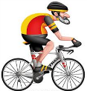
Practice
Posted speeds are relative to the chicken!
v = 0 m/s
v = 15 m/s
v = 19 m/s
v = 3 m/s
v = 21 m/s
1. Relative to the pink car, how fast is the orange car moving? The bus? The cyclist?
4 m/s
-36 m/s
-12 m/s
2. If an old man on the front of the bus were to jog to the back of the bus at a speed of 2 m/s relative to the bus:
a. What is his speed relative to the chicken? The pink car?
-19 m/s
-34 m/s
3. How fast is everything moving (relative to the Earth) if the posted speeds were listed relative to the cyclist?
Pink car Orange car Chicken Bus
18 m/s
22 m/s
3 m/s
-18 m/s

Slide 41
Planes and the wind
What is the velocity of the plane relative of to the Earth?
Plane speeds are posted relative to the air
Headwind
Tailwind
20 m/s
20 m/s
v = 50 m/s
v = 50 m/s
20 m/s
v = 50 m/s
20 m/s
30 m/s
70 m/s
v = 50 m/s
53.8 m/s

