Slide 1
Bell Ringer
V (m)
X (m)

Slide 2
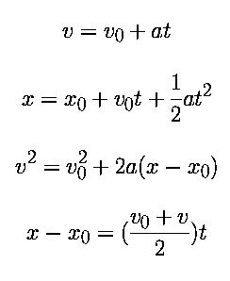
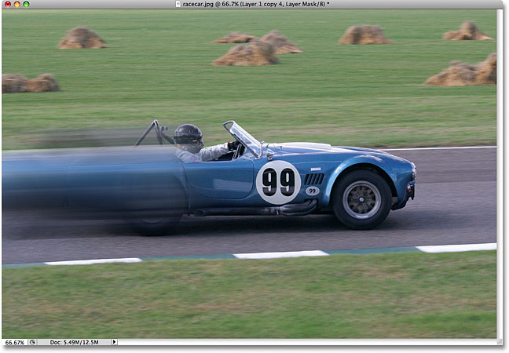
Kinematics

Slide 3
We need a set of equations to do work for us!!!
Here is where we will start …….
v
Slope =
acceleration
vi
t
y = m x + b
It’s as easy as that! Our first Kinematics equation!
$$v_{f}=at+v_{i}$$

Slide 4
For my next trick!
v
$$\frac{1}{2}\left(v_{f}−v_{i}\right)t$$
v_{i}
$$v_{i}t$$
t
What would the area of this graph tell me?
Units (m)
Displacement: $x_{f}$ - $x_{i}$
Find an symbolic equation for the area of the graph.
Area = v_{i} t+ ½ (vf - vi)t
xf - xi = v_{i} t +½ vf t - ½ v_{i} t
xf - xi = ½ vf t + ½ v_{i} t
xf = xi + ½ (vf + vi)t
Notes:
A2

Slide 5
Ready for some more fun?
xf = xi + ½ (vf + vi)t
vf = at + vi
xf = xi + ½ ((at + vi) + vi)t
xf = xi + ½at² + ½vit + ½vit
xf = xi + vit + ½at²

Slide 6
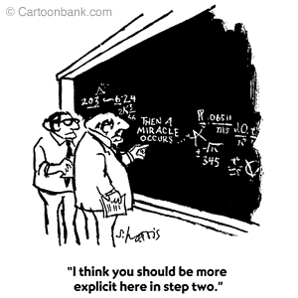
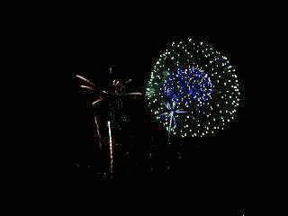
Last Time
For this last one, we need to start with a couple of different equations:
xf = vavg *t + xi
vavg = (vf + vi)/2
vf = at + vi
solve for t
t = (vf – vi)/a
xf = [(vf + vi)/2] *[(vf – vi)/a] + xi
xf -xi = [(vf + vi)/2] *[(vf – vi)/a]
vf² = vi² + 2a(xf - xi )
xf-xi = [(vf + vi )(vf – vi)]/2a
2a(xf-xi ) = vf² - vi²

Slide 7
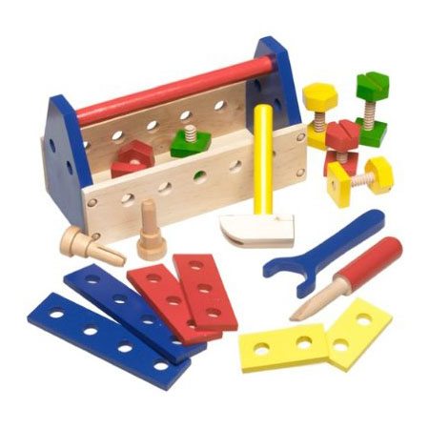
The Final Product
These are powerful because each equation is independent of one of the other variables
So here is what we went to all that work for.
Our new and improved tool kit!
Independent
$$v_{f}=v_{i}+at$$
xf , xi
$$x_{f}=x_{i}+\frac{1}{2}\left(v_{f}+v_{i}\right)t$$
a
$$x_{f}=x_{i}+v_{i}t+\frac{1}{2}at^{2}$$
vf
$${v_{f}}^{2}={v_{i}}^{2}+2a(x_{f}−x_{i})$$
t
Now we can really solve problems!

Slide 8
The Fool Proof way to solve problems
You must be a physics NINJA!
With my Six step program no problem will ever be able to withstand you!
Physninjiks! | Ninjas | Physics Students
Step 1
Visualize Your Enemy
DRAW A PICTURE
Step 2
Understand Your Enemy
MAKE A DATA TABLE!
Step 3
Find The Enemy’s Weakness
What variable are you looking for?
Step 4
Choose Your Weapon!!
Choose your Equation!!
Step 5
Kill Your Enemy!!!!
Plug and Chug
Step 6
Check for a Pulse
Check your answer

Slide 9
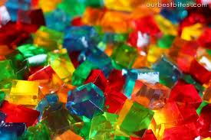
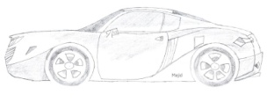
Practice Battle!!
Jimmy is flying down the road at 80 m/s in his rocket car when he runs into an infinite wall of JELLO. It takes his car 35 s to come to a complete stop (meanwhile Jimmy’s mouth is totally open).
v= 80 m/s
What is the acceleration on Jimmy?
How far does Jimmy travel into the Jello?
t= 35s
vf = at + vi
We like 0’s because they KILL stuff!
0 = a(35) + 80
x
xi =
xf =
vi =
vf =
a =
t =
Which equation has the variable I need to know, but does not contain the one I don’t know?
a = -2.3 m/s²
0
vf = at + vi
a = -80/35
?
80 m/s
xf = xi + ½ (vf + vi)t
0
xf = xi + vit + ½at²
xf = xi + vit + ½at²
?
35 s
vf² = vi² + 2a(xf - xi )
Xf = 0 + 80 (35) + ½ (-2.3) (35)²
Xf = 1391 m

Slide 10
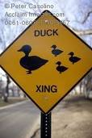
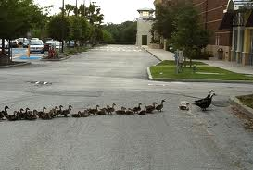
Battle #1
Jane is driving down the road in her school bus at 42 m/s when she notices a flock of baby ducks trying to cross the road 85 m ahead of the bus. She immediately slams on the brakes, giving the bus an acceleration of – 2.5 m/s².
a=-2.5 m/s²
42 m/s
85 m
Prove whether or not the baby ducks will live to see another day……
vf = at + vi
x
xi = 0
xf = ?
vi = 42
vf = 0
a = -2.5
t = ?
vf² = vi² + 2a(xf - xi )
xf = xi + ½ (vf + vi)t
0 = 42² + 2 (-2.5) (xf – 0)
xf = xi + vit + ½at²
-1764 = -5 xf
vf² = vi² + 2a(xf - xi )
Xf = 352 m

Slide 11
Practice
v (m/s)
IF the object is begins at a position of zero, what will its final displacement be?
8 m/s for 5 s
=
40 m
$$x_{f}=x_{i}+\frac{1}{2}\left(v_{f}+v_{i}\right)t$$
x
xi =
xf =
vi =
vf =
a =
t =
x
xi = 0
xf = ?
vi = 3 m/s
vf = 8 m/s
a = 5/4 m/s²
t = 4s
t (s)
$$x_{f}=0+\frac{1}{2}\left(8+3\right)4$$
3 m/s for 5 s
=
15 m
$$x_{f}=22m$$
15m + 40m + 22m
=
77m

Slide 12
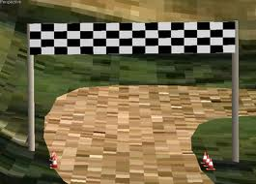
Battle #2
Jimmy and Jane are in a race. Jane is 100 m from the finish line running at a constant rate of 2.3 m/s. Jimmy is 140 m from the finish line and running at a rate of 3 m/s. What would Jimmy’s acceleration need to be in order cross at the same time as Jane?
3 m/s
2.3 m/s
100 m
140 m
x Jimmy
xi = 0
xf = 140 m
vi = 3
vf = ?
a = ?
t = ?
x Jane
xi = 40 m
xf = 140 m
vi = 2.3 m/s
vf = 2.3 m/s
a = 0
t = ?
xf = xi + vit + ½at²
xf = xi + vit + ½at²
140 = 40 + 2.3t + 0
140 = 0 + 3 (43.5) + ½a(43.5)²
2.3t = 100
140 – 130.5 = 946 a
t = 43.5 s
a = 0.01 m/s²

Slide 13
For my next trick!
x
Slope =
Velocity
xi
t
y = m x + b
xf = ((vf + vi)/2)t + xi
xf = vavg *t + xi
vavg = (vf + vi)/2
xf = xi + ½ (vf + vi)t
*This simple average only works when the acceleration is constant!

