Slide 1
Bell Ringer
You are 4.6 miles from Westlake High School, when all of a sudden you remember that you forgot something at home, so you head back home which is 17.3 miles from Westlake High School in 20 minutes and pick it up. You then turn back and go to school, which takes you an additional 21 minutes.
What is your average velocity during the time you rushed home?
What is your average velocity during the time you rushed back to school?
What is your average velocity overall?

Slide 2
Science Matters
Lightning

Slide 3
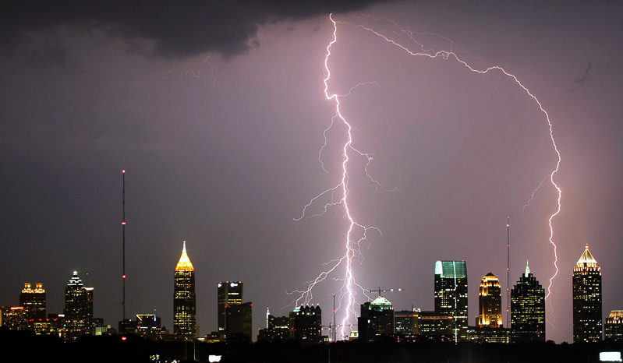
Lightning never strikes the same place twice?

Slide 4
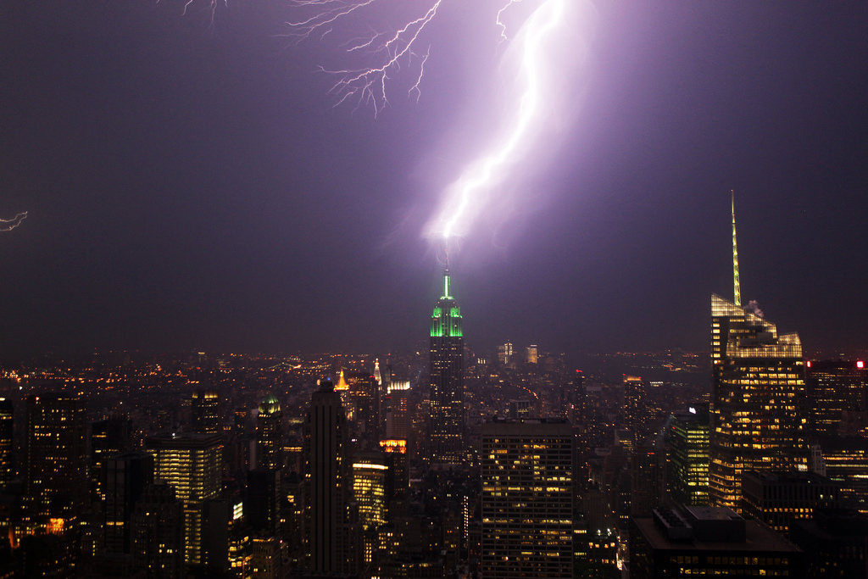
FALSE!
Empire State Building struck about 25 times a year
One park ranger was struck seven times by lightning, and still lived
Lightning strikes taller objects, especially ones that conduct electricity, more often

Slide 5
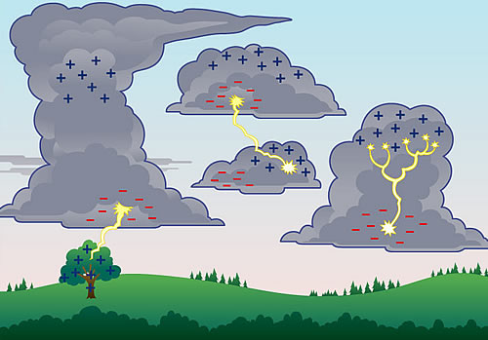
What to do?
If you are in a car, stay inside of it! It’s actually one of the safer places to be in a lightning storm.
If you are outside, find low ground.
DO NOT lay down. You want as little contact with the ground as possible because lightning spreads across the ground.
DO crouch down on the balls of your feet.
Find shelter inside if you are close.

Slide 6
Motion Maps
A New Way To Represent Motion

Slide 7
Motion Maps
Suppose you took a strobe photo of a boat moving to the right at constant velocity, where each image revealed the position of the boat at one second intervals.

Slide 8
This is a MOTION MAP that represents the boat. The DOTS represent the POSITION of the boat at each time interval.
The ARROWS represent the VELOCITY of the boat. (Recall that 1 second passes between photos)

Slide 9
If the boat were moving faster, the strobe photo might look like this:
The MOTION MAP would look like this:
(Note: the distance between dots is greater than before; but each interval is still one second.)

Slide 10
If the boat were moving to the left, the photo and motion map would look like this:

Slide 11
More complicated motion can be represented as well.
Here, an object moves to the right, constant velocity; stops for two seconds, then moves left at twice the initial speed.

Slide 12
Change of Direction
Note that when the direction changes, we put the new dots above the old ones. The bottom of a motion map is the starting position.

Slide 13
Consider the following motion map for two cyclists:
Notice that they have different starting positions!
A
B

Slide 14
Even though the dots do not line up, the first dot represents a picture taken when time = 0 s, the 2nd dot a picture taken when time = 1 s, and so on. What would a position vs. time graph of this motion map look like?
t = 0 s
t = 2 s
t = 1 s
t = 3 s
A
B
t = 0 s
t = 1 s
t = 2 s
t = 3 s

Slide 15
Here is a Position-Time graph of the same motion. At t = 2 s, both cyclists are at the same position.
B
X
(m)
A
2
T (s)

Slide 16
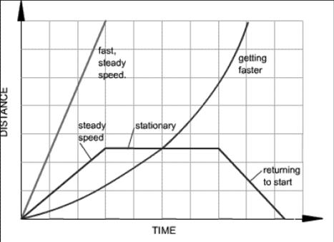
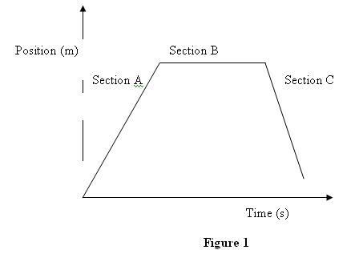
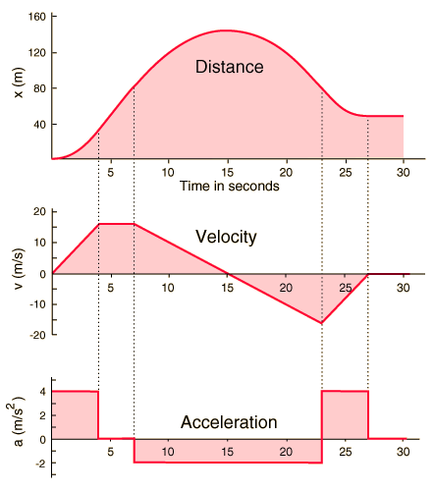
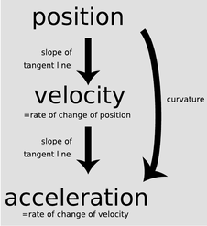
Graphing and Motion

Slide 17
Position vs. time graphs and Slopes
Remember slope is just
rise over run.
It tells us how fast something is changing.
In other words, it gives us a
rate of change!
slope=
0
t
x
slope=
+
constant
Just like in math class
5/4 positive
10/4 bigger positive
2/4 smaller positive
-5/4 negative
-10/4 bigger negative
-2/4 smaller negative
t
x
slope=
-
0 / 4 = 0
t

Slide 18


Understanding graphs of motion
x
What does slope mean?
--Rate of change
--The slope of a position
graph is :
Velocity!!!
v
slope=
0
slope=
0
t
What is the slope?
x
slope=
+
constant
v
slope=
0
What would the velocity graph look like?
t
x
v
slope=
-
constant
The slope = the velocity!!!!!!
t
slope=
0

Slide 19

Practice
Draw the Velocity vs. Time graph that matches the shown graph:
Slope
0 m/s
X (m)
What is the graph going to look like?
Will it have constant or changing velocity?
Slope
6m/3s =
2 m/s
Slope
-4m/1s =
-4 m/s
Slope
3m/3s =
1 m/s
1 m
Slope
0 m/s
t (s)
2s
The slope tells us what the velocity is between certain times

Slide 20
Practice
V (m/s)
What would the acceleration graph look like for this?
1 m/s
t (s)
2s

Slide 21
Understanding graphs of motion
slope=
+
x
v
slope=
+
t
0
t
slope=
Use your pencil to find the slope
slope=
0
x
v
slope=
-
t
t
slope=
-
Now let’s go the other way
x
v
value =
+
What do these values
tell us about the slope?
value =
0
t
Connect the line segments
with a curve
t
value =
-

