Slide 1
Bell Ringer
I want to find how tall a cliff is, so I drop a rock off and it takes 4.3 seconds for me to hear it hit the ground. How tall is the cliff?
How fast would an object dropped off a 20 meter building be going as it hits the ground?

Slide 2
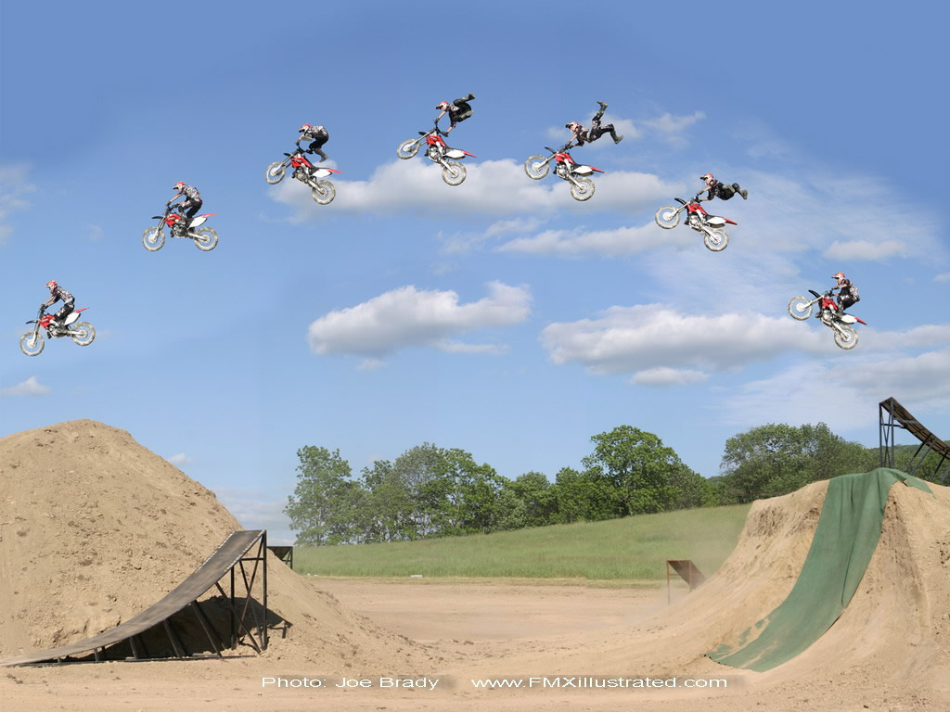
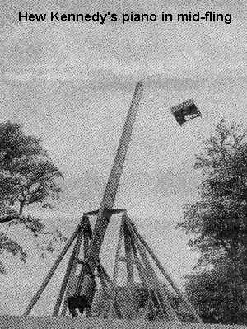
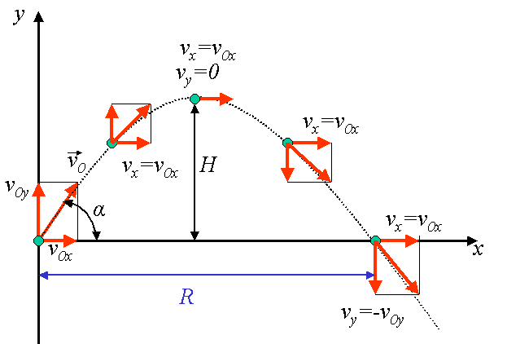
Projectile Motion

Slide 3
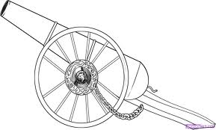
Describe the motion of the cannon ball if we fired it like this
The ball will move along a vertical path being accelerated by gravity!!
The ball will move along a horizontal path at a constant velocity!!

Slide 4
Sketch graphs of the motion
Horizontal
Vertical
x
v
a
t
t
t
y
v
a
t
t
t

Slide 5
Sketch graphs of the motion
Horizontal
Vertical
x
v
a
t
t
t
y
v
a
t
t
t

Slide 6
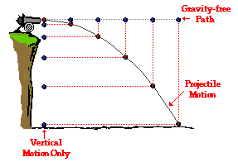
By combining the distance traveled in both directions
I am able to see the parabolic curve of the projectile ☺

Slide 7
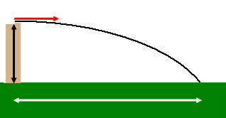
Penny Lab
$$v_{f}=v_{i}+at$$
Flick a penny off your table
Calculate the initial velocity of the penny
$$x_{f}=x_{i}+\frac{1}{2}\left(v_{f}+v_{i}\right)t$$
$$x_{f}=x_{i}+v_{i}t+\frac{1}{2}at^{2}$$
$${v_{f}}^{2}={v_{i}}^{2}+2a(x_{f}−x_{i})$$
How are we going to do this?

Slide 8
You must be a physics NINJA!
With my Six step program no problem will ever be able to withstand you!
Physninjiks! | Ninjas | Physics Students
Step 1
Visualize Your Enemy
DRAW A PICTURE
Step 2
Understand Your Enemy
MAKE A DATA TABLE!
Step 3
Find The Enemy’s Weakness
What variable are you looking for?
Step 4
Choose Your Weapon!!
Choose your Equation!!
Step 5
Kill Your Enemy!!!!
Plug and Chug
Step 6
Check for a Pulse
Check your answer

Slide 9
What is the same for both the vertical component and the horizontal component?
TIME!!

Slide 10
Penny Lab
$$v_{f}=v_{i}+at$$
Flick a penny off your table
Calculate the initial velocity of the penny
$$x_{f}=x_{i}+\frac{1}{2}\left(v_{f}+v_{i}\right)t$$
$$x_{f}=x_{i}+v_{i}t+\frac{1}{2}at^{2}$$
$${v_{f}}^{2}={v_{i}}^{2}+2a(x_{f}−x_{i})$$
Xi =
Xf =
Vi =
Vf =
a =
t =
Yi =
Yf =
Vi =
Vf =
a =
t =
0
0
0
0
10

Slide 11
Bullet dropped, or a bullet fired?

Slide 12
Now take two pennies and do the following
Place one of the pennies at the edge of the table so that it hangs over slightly.
Place the second penny in the middle of the table some distance from the first penny.
Flick the penny in the middle of the table so that it hits the other penny just barley knocking it off the table.
As both coins fall to the floor which coin hits the ground first?
https://www.youtube.com/watch?v=zMF4CD7i3hg

Slide 13
What if I fire the cannon like this?
What do we have to do to with the velocity?
The path of the ball is now parabolic.
It is a combination of the two previous motions!

Slide 14
A detailed picture of the projectile in flight
t = 2 s
t = 3 s
t = 1 s
10 m/s
0 m/s
t = 4 s
t = 0 s
20 m/s
40 m/s
30 m/s
40 m/s
40 m/s
t = 5 s
50 m/s
-10 m/s
40 m/s
40 m/s
t = 6 s
40 m/s
-20 m/s
40 m/s
A perfect combination of Horizontal and Vertical motion!
-30 m/s

Slide 15
The Horizontal component of motion | The Vertical component of motion | The Apex: The very top of the flight path
No Acceleration!!!!
Gravity is in control of the motion
Y component of velocity is ZERO
Acts just like an object in Free Fall
In most cases, this represents half of the flight time!
i.e. The velocity Never!!
Changes
t = 2 s
t = 3 s
t = 1 s
10 m/s
0 m/s
t = 4 s
t = 0 s
20 m/s
40 m/s
30 m/s
40 m/s
40 m/s
t = 5 s
-10 m/s
40 m/s
40 m/s
t = 6 s
40 m/s
-20 m/s
40 m/s
-30 m/s

Slide 16
What is the same for both the vertical component and the horizontal component?
TIME!!
http://www.physicsclassroom.com/Physics-Interactives/Vectors-and-Projectiles/Projectile-Simulator/Projectile-Simulator-Interactive
t = 2 s
t = 3 s
t = 1 s
10 m/s
0 m/s
t = 4 s
t = 0 s
20 m/s
40 m/s
30 m/s
40 m/s
40 m/s
t = 5 s
-10 m/s
40 m/s
40 m/s
t = 6 s
40 m/s
-20 m/s
40 m/s
-30 m/s

Slide 17
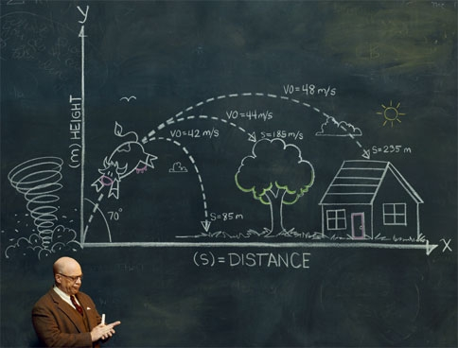
How do we solve projectile motion problems?

Slide 18
How to solve projectile motion problems
15 m/s
Max
Height
25 m/s
Range
Find the time in the air using the information in the vertical (y) direction
at apex

Slide 19
How to solve projectile motion problems
15 m/s
Max
Height
25 m/s
Range
Find the time in the air using the information in the vertical (y) direction
at apex
0
0
?
?
0 = 15 + (-10)t
15 m/s
25 m/s
0
25 m/s
-15 = -10t
-10 m/s²
0 m/s²
x 2
?
?
t = 1.5 s
3 s for the full arc
2. Find the Range using the time you just found and the information in the horizontal (x) direction
x = 75 m
3. Find the maximum height the projectile reaches using the vertical information and the Apex.

Slide 21
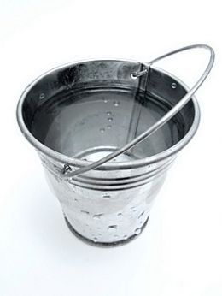
Practice
Jimmy is loaded into a cannon and fired with an initial velocity of 50 m/s at an angle of 35 degrees. How far away from the cannon does Jane need to put the bucket of water that Jimmy will be landing in?
Initial Velocity Triangle
50 m/s
x = 234 m
0 = 28.6 + (-10)t
-28.6 = -10t
t = 2.86 s
5.72 s
x 2

Slide 22
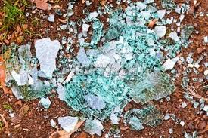
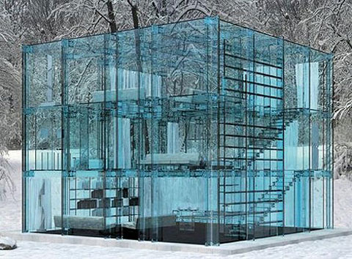
Practice
Jane is delivering a piano to Jimmy’s brand new glass house. Jane’s plane is flying at 70 m/s at an altitude of 156 meters. How far back from the house does Jane need to release the piano to deliver it?
Start at the apex!
x = 392 m

Slide 23
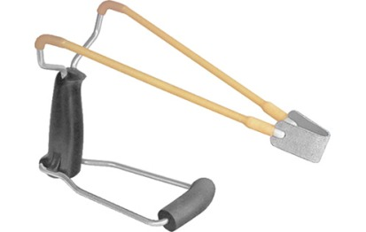
Practice
Jimmy is attempting to return the now defective piano to its original owner but she is slowly escaping by boat. How far from the base of the cliff will Jane be when Jimmy needs to fire the piano?
v= 67 m/s
52m
Whole Trip
X
t = 11.06 s
You need to use the quadratic formula!

Slide 24
http://www.physicsclassroom.com/Physics-Interactives/Vectors-and-Projectiles/Turd-the-Target-2/Turd-the-Target-2-Interactive
If there is time

