Slide 1
Balloon Balanced forces
Balanced forces, is are the forces on the balloon balanced?
How do you know?
Draw the force Diagram for the balloons.
Are they balanced?
We have a buoyant force.
So what can I do if I want to balance out the buoyant force with just the force of gravity?
How can I increase the force of gravity? Do we have an equation for that?
What is it?
How will we know when it is balanced?
So…..
Now it is balanced so what equation can we write?
Fg=Bf
How much mass does it need to balance?
Calculate the buoyant force for me. 3 balloons created that Buoyant force.
Can we lift the house from up?
What does it need to be, balanced of unbalanced?
Calculate how many balloons it would take to lift a balloon.
Friction lab.

Slide 2
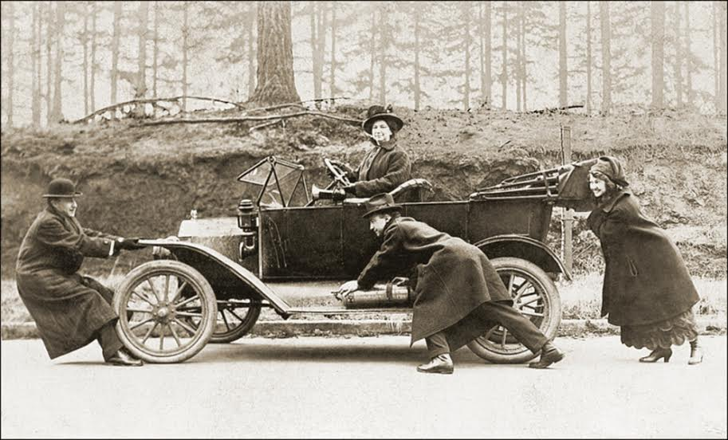
Bell Ringer
You and a friend are both trying to move your cruddy car that has broken down once again. The car has a mass of 500kg. You are pulling the car up with a force of 100N at an angle of 20 degrees. Your friend is pushing down on the car with a force of 120N at an angle of 40 degrees. If the car is moving at a constant velocity, how much friction is acting on the car? How much normal force is acting on the car?

Slide 3
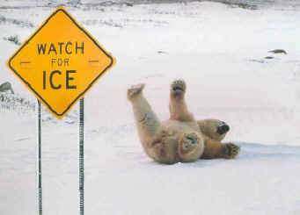
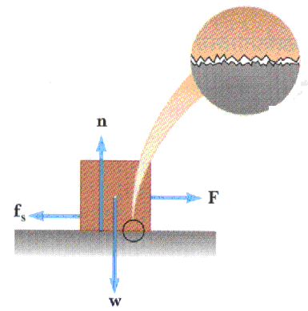
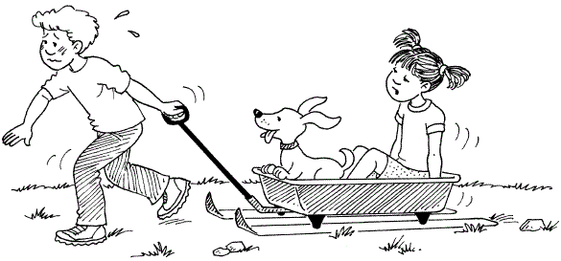
Friction

Slide 4
Draw a force diagram for a mass being dragged along the desk at a constant speed.
What is the force of friction from the table on the mass?
If you increase the mass you are pulling what happens to the normal force?
Take a mass and drag it across your desk at a constant speed. Try different masses.
As you increase the Normal force what happens to the force of friction?

Slide 5
Now, with the mass starting at REST, slowly pull on the mass until it begins to move, then keep it moving at a constant velocity.
What happens to the force of friction right after it begins to move?
Repeat this process for a few other masses, what do you see? Is the result any different?
Is the force of friction greater just before the object moves or just after it moves when it’s velocity is constant?
Why?

Slide 6
Now pull the mass again across 3 different surfaces that seem to either be rougher or smoother than the previous surface.
Compared to the last surface, was the force of friction greater than or less than what it was before?
Why?
If you use the same mass, how can you get the force of friction on an object to increase?

Slide 7
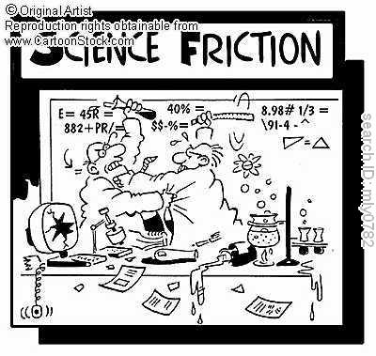
From the activity…
The Force of friction is directly proportional to the Normal Force!
When the Normal force goes up, the force of Friction goes up
The amount of friction you have depends on the surface of the materials
$$F_{f}=μ∗N$$
Coefficient of Friction

Slide 8
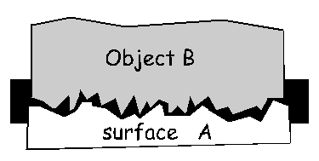
What is Friction?
Friction is a force that resists the motion between two objects in contact with one another.
Even though surfaces might not seem rough or jagged, if there are causing friction, they are!!

Slide 9
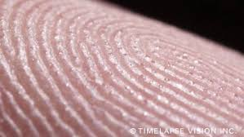
Human skin

Slide 10
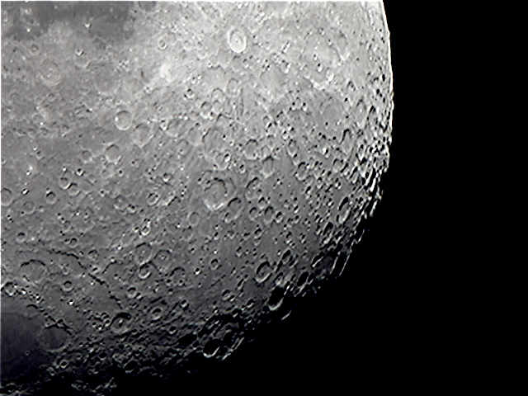
Moon

Slide 11
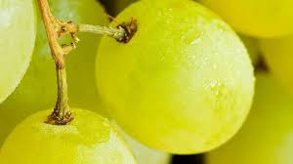
grapes

Slide 12
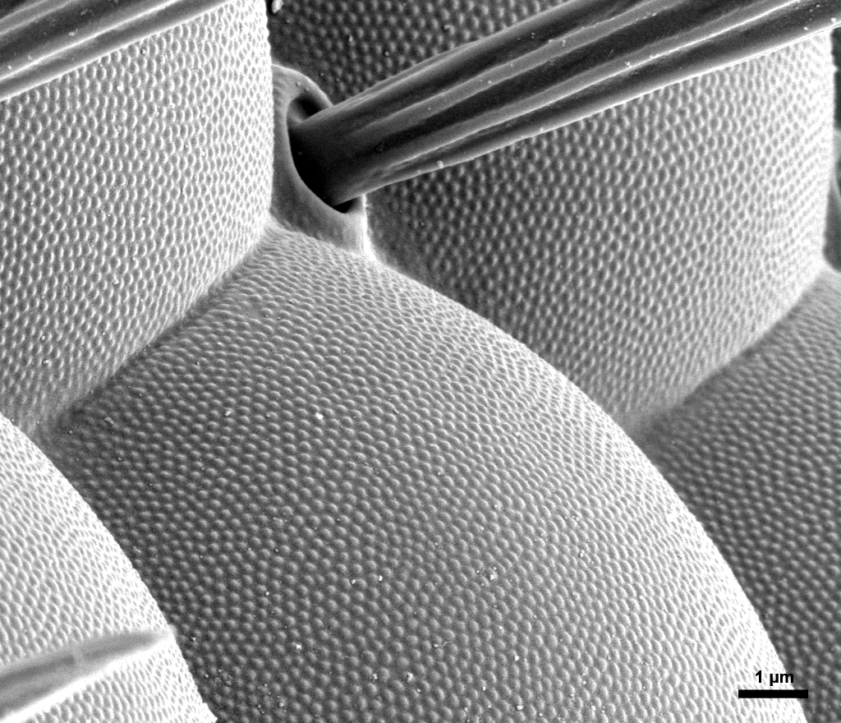
Eye of a Fruit Fly

Slide 13
Jelly Beans

Slide 14
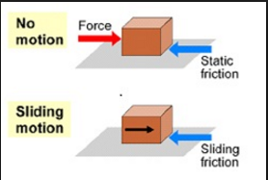
Two kinds of Friction:
What happened to the amount of friction between the block and the sandpaper as soon as the block started moving?
It went down!
At first the friction is STATIC
and as soon as the desk moves
the friction becomes KINETIC

Slide 15
Two kinds of Friction:
At first you slowly apply more and more force
Eventually the desk will slip and start moving.
This is where the mass
Slips!!!
Ff
Static
Kinetic
t

Slide 16
Ff
SLIP
Static
Kinetic
t
Static Friction | Kinetic Friction
Object NOT moving
Object IN motion
Amount of friction there is depends on the force it is resisting
Once the object is moving, the amount of friction is CONSTANT!!!!!!!!!!!

Slide 17
$$F_{f}=μ∗N$$
We know what “N” is, it is the Normal force, but what is
is the coefficient of friction.
The coefficient of friction:
Is a constant that depends on the surfaces of the materials.
If $μ$ is large then there will be a lot of friction and if it is small there will only be a small amount of friction.

Slide 18
Because there are two types of friction there are also 2 coefficients of friction for each surface.
s is the coefficient of static friction and we use it if our object is not moving
k is the coefficient of kinetic friction and we use it if our object is moving
Both s and k are constants that you can look up in a table to calculate the friction between any two surfaces
For Example….

Slide 19
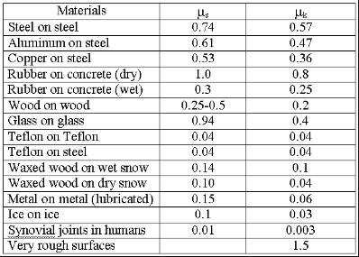
Notice, the cof. of static friction is always bigger than
the cof. of kinetic friction!

Slide 20
Practice
Jane is towing Jimmy across a field at a constant velocity with a force of 54N. If Jimmy has a mass of 85 kg what is the coefficient of kinetic friction between Jimmy and the field?
N
X Y
$$F_{f}=54$$
N = 850
Ff
54 N
$$μN=54$$
$$μ∗850=54$$
W
$$μ=\frac{54}{850}$$
= 0.064

Slide 21
MT = 149 kg
F=287N
28°
If the sled is moving at a constant velocity, what is the coefficient of kinetic friction?
N
287 N
287*sin(28) = 134.7
287 N
28°
Ff
287*cos(28) = 253.4
X
Y
W = 1490N
$$F_{f}=253.4$$
$$N+134.7=1490$$
$$μN=253.4$$
$$N=1490−134.7$$
$$μ(1355.3)=253.4$$
$$N=1355.3$$
$$μ=\frac{253.4 }{1355.3}=0.19$$

Slide 22
Bell Ringer
The car has a mass of 500kg. You are pulling the car up with a force of 100N at an angle of 20 degrees. Your friend is pushing down on the car with a force of 120N at an angle of 40 degrees. If the car is moving at a constant velocity, what is the coefficient of kinetic friction?

Slide 23
Now it is your turn to make your own coefficient of friction table!
On a separate piece of paper, with 2-3 other people, construct a table that gives the coefficient of static and kinetic friction between 5 different surfaces.
For each different surface, show your
Force diagram
Your balanced force equations and
The calculations you used to get your coefficients
In other words, show all your work.
At the end of the lab you should have a table that names the two surfaces and gives us and uk for each

