Slide 1
Quiz---Draw the Force Diagram
To the right is positive and forward!
A book is sliding down a frictionless ramp.
An old box hangs from the ceiling by two ropes.
Jane is pulling Jimmy on a sled across a field by a rope at an angle.
A car crashes into a giant wall.
Extra Credit

Slide 2
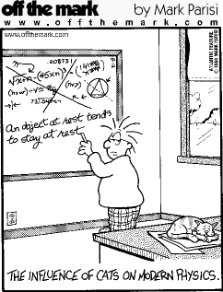
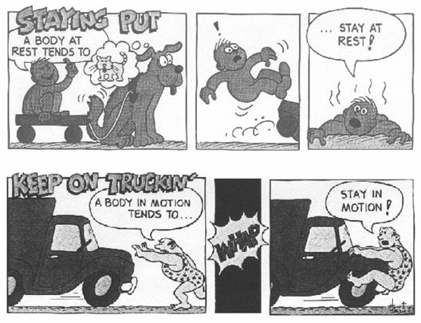
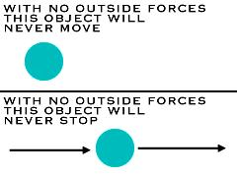
Newton’s First Law

Slide 3
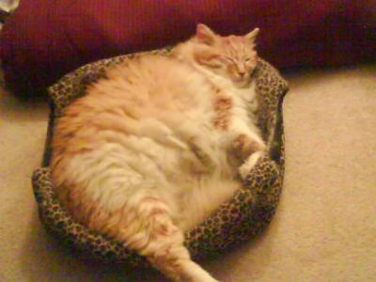
What is Newton’s First Law of Motion?
An object at rest or in motion will remain at rest or in motion until acted upon by an outside force!
Video Link

Slide 4
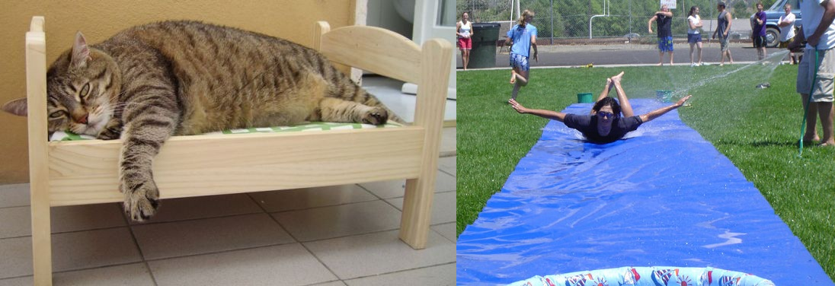
What does that actually say??
An object with 0 velocity will remain at 0 velocity, and an object going 5 m/s will continue going 5 m/s until it gets pushed or pulled by some force!

Slide 5
Table cloth video.
https://www.youtube.com/watch?v=JqZOUgACPF0
https://www.youtube.com/watch?v=PcGIUZzWoVc
Floating disk
We are going to watch a small part of a video.
After we watch this video I need you to tell your neighbor why he is wrong and what the correct answer is. What really would happen if we had an no unbalanced force.
Incorrect law of motion. Why is it incorrect?
https://www.youtube.com/watch?v=gwPaGVUSzj4

Slide 6
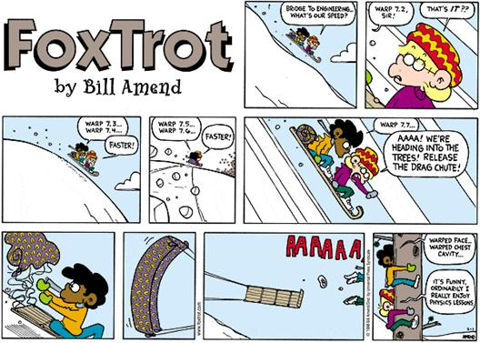

Slide 7
An object with 0 velocity will remain at 0 velocity, and an object going 60 m/s will continue going 60 m/s until it gets pushed or pulled by some force!
What does a push or a pull do?? What is going to change once a force is applied to it?
What is a change in velocity???
ACCELERATION!!!
Notes:
So what’s going to happen to it once there is a force applied to it? What is going to change?

Slide 8
Tell your neighbor, using the concepts of newton’s first law, which egg is hard boiled and which one is not.

Slide 9
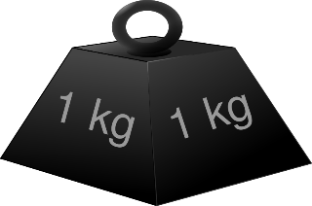
What is the force diagram for this object?
We are going to measure the force for different masses.
Then we will graph our results like so…
F 10
8
6
4
2
What is the force we are calculating?
Think about our force diagram…
0.2 0.4 0.6 0.8 1 kg

Slide 10
Grab a white board…
On your white board draw what you believe will happen.
As the mass increases, what will happen to the force?
Is the slope of this line getting steeper?
F 10
8
6
4
2
What is the slope of this line?
F/m = 9.8 m/s/s
F = a
m
If you want a mass to accelerate at a certain rate you need the right force.
F = m a
0.2 0.4 0.6 0.8 1 kg

Slide 11
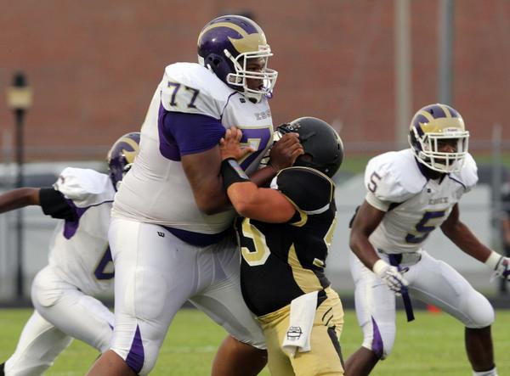
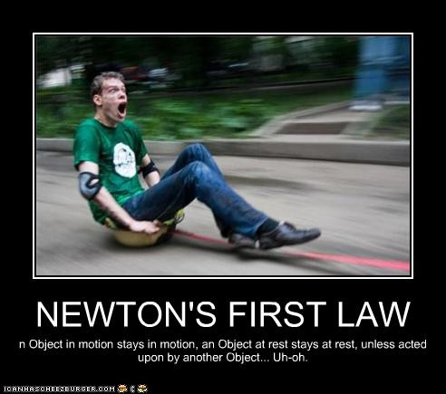
Inertia
: All about Mass

Slide 12
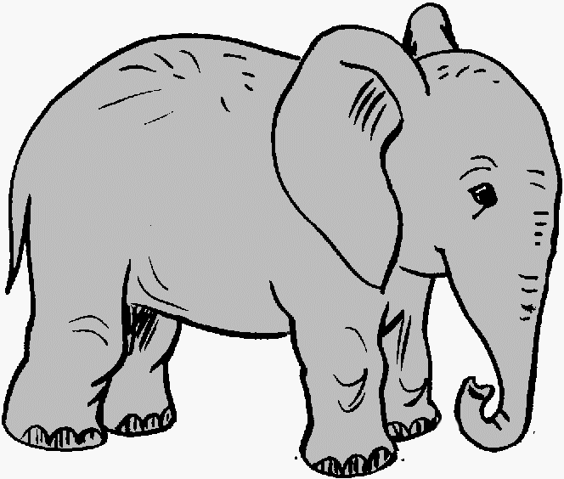
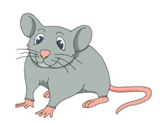
Inertia
Symbol : m
Unit : kg
: All about Mass
An object’s ability to resist changes in motion!
Which object has more mass?
What is mass?
It is the amount of matter (stuff) you are made of
Vs.

Slide 13
Practice
If you wanted to accelerate a 50 kg bowling ball at a rate of 1 m/s/s, how much force would it take?
If you wanted to accelerate a 5 kg soccer ball at a rate of 1 m/s/s, how much force would it take?

Slide 14
Inertia
: All about Mass
Simply put, the more inertia something has, the harder it will be to get it to move or to change it’s state of motion.
It will need a greater amount of force!!
Inertia has nothing to do with an object’s speed!!
Only it’s mass!!!

Slide 15
Inertia
: All about Mass
If #77 has a mass of 77 kg, and you want to accelerate him at a rate of 1 m/s/s,
How much force would you need to push him with if he was standing still?
Running at 1 m/s?
Is the force different or the same?
Why?
Inertia has nothing to do with an object’s speed!!
Only it’s mass!!!

Slide 16
Why does the earth spin?
https://www.youtube.com/watch?v=9zso7ChaQXQ 4min
https://www.youtube.com/watch?v=TQxeutcYP6I 2min

Slide 17
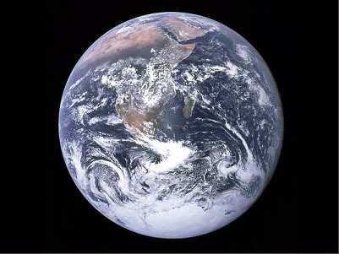
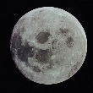
Weight vs. Mass
Are these two concepts the same?
NO !!!!!!!!!!!!
Mass = amount of stuff
Weight = Force of Gravity
$$W=m∗g$$
Where do you weigh more?

Slide 18
Practice
If you had a mass of 237 kg, how much would it weigh (force of gravity)?
If you found something that weighed 469 N, what is its mass?

Slide 19
Practice
If a mass of 88 kg was accelerated by gravity at a rate of 15m/s/s how much would it weigh (force of gravity)?
If you found something that weighed 469 N, on another planet, and you knew it’s mass was 63 kg then what would the acceleration due to gravity on that planet?

Slide 20
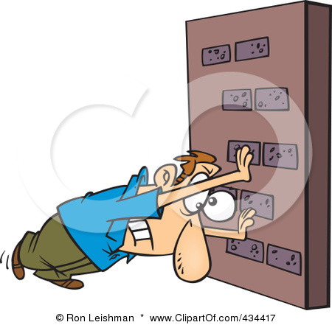
Balanced Forces
How do you know if the forces acting on an object are balanced?
If the object is not moving
If the object is moving at a constant velocity
The Acceleration
=
ZERO

Slide 21
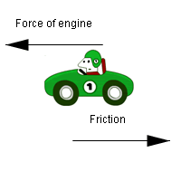
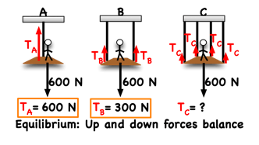
Balanced Forces
When the forces on an object are balanced they will all add up to …
ZERO
In a car, when you speed up to go as fast as you can go, but you can’t go any faster, then the wind and friction are pushing just as hard back at you in the other direction.

Slide 22
What would the force diagram be if bucket was accelerating?

Slide 23
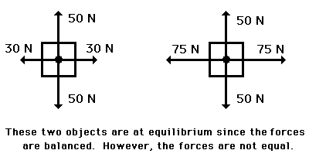
Balanced Forces
When the forces on an object are balanced they will all add up to …
ZERO
Vertical:
UP Forces = Down Forces
Horizontal:
Left Forces = Right Forces

Slide 24
How much force in the X and Y direction is needed to balance the forces?
X: 2N Right
Y: 3N Up
2N
What resulting force would that be?
4N
6N
$$\sqrt{2^{2}+3^{2}}$$
3N
3.605N
5N
2N
What angle would the force be directed at?
$${θ=tan}^{−1}\left(\frac{3}{2}\right)=56.30°$$

