Slide 1
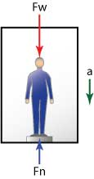
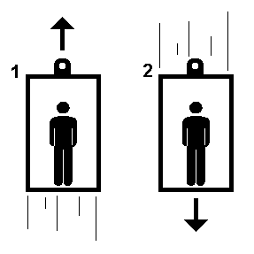
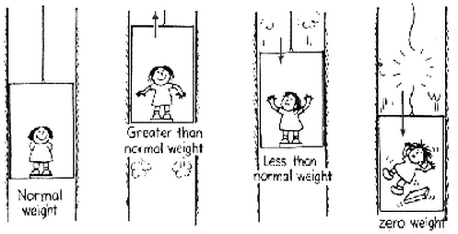
Elevators

Slide 2
Elevator Discussion
What does it feel like when an elevator begins to rise?
What happened to the scale reading?
What force accelerates you up?
What does it feel like when an elevator comes to rest at the top?
What happened to the scale reading?
What force accelerates you down?
Was the weight really changing? Why or why not?

Slide 3
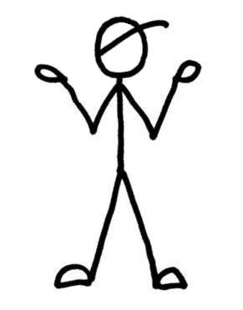
Elevators
What does it feel like when an elevator begins to rise?
Force Diagram
for Jimmy:
N
Which force is responsible for moving you UP?
The Normal Force
What does it feel like when an elevator comes to rest at the top of a floor?
W
Think about how the force diagram will change to accommodate the motion
Which force is responsible for stopping you?
Gravity

Slide 4
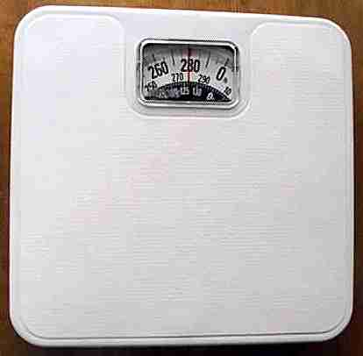
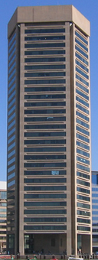
Scales
What force does a bathroom scale actually read?
The Normal Force!!!
Think about the following situations:
What does scale read at the top of the building?
Her weight!
What does it read as she falls?
Zero?????
What will it read when she hits the ground?
A huge number……

Slide 5
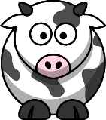
Practice
Jimmy has loaded a herd of cattle onto the elevator of Jane’s apartment building….
There are 25 cows in the elevator and each cow has a mass of 110 kg. When the elevator begins to haul the animals to the top a scale registers a weight of 30,000 N.
What is the acceleration of the cows?
N
$$N−W=ma$$
$$30000−27500=2750∗a$$
$$a=0.909 m/s^{2}$$
W

Slide 6
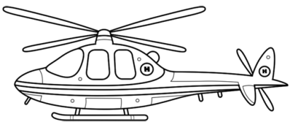
Practice
In an attempt to escape the herd of cows, Jane climbs aboard her helicopter and takes off. The helicopter accelerates upward at a rate of 12 m/s² , and Jane has a mass of 54 kg. Jane just happens to be sitting on a scale, what does the scale read her weight to be?
$$N−W=ma$$
$$N−540=54∗12$$
$$N=1188N$$

