Slide 1
BELL RINGER:
What was the most stressful part about the first day of school?
If I turn in homework 3 days late, what happens to the grade for that assignment?
If I turn in homework 1 day late, what happens to the grade for that assignment?
What is Physics the study of?

Slide 2
POP QUIZ
In each case, solve for X
1. 3x = 27
2. 14x² = 56
3. 7x – 3 = 18
4. 7(x – 3) = 18
5. x² + x – 4 = 0
6. Find ‘x’:
30°
X
10 in

Slide 3
Science Matters
Typhoon Hato

Slide 4
Typhoon Hato: Twelve killed as storm sweeps south China
Typhoon Hato made landfall at noon on Wednesday near Zhuhai city in Guangdong province, bringing with it strong winds and lashing rain.
The storm caused widespread flooding, blackouts and destruction.

Slide 5
Meteorology = Atmospheric Physics
Predict 3-5 days in advance
Use of satellite, GPS, Communication towers
What kind of benefits could this bring?

Slide 6
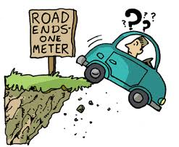
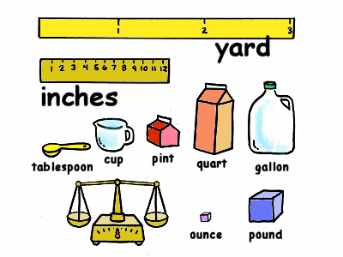
Units and Measurement

Slide 7
What are Units?
Main purpose is to give numbers meaning!
If I tell you, “I’ll be back in 5…”
Seconds
Hours
Minutes
Years……
You never know when I’m coming back.

Slide 8
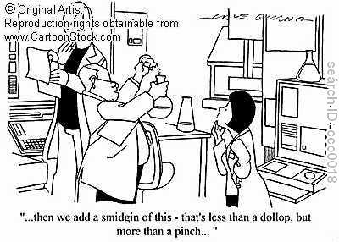
In physics you MUST keep track of your Units!
They let you know what you are dealing with.
Help you keep track of the correct answer.
You can use them to check if your equations are bogus.

Slide 9
Two Systems of Measurement
Old English System
In, ft, yards, miles
cups, quarts, gallons
Farenheight
seconds, minutes, hours
Slugs
Pounds
Metric System
Meter
Liter
Celsius
seconds, minutes, hours
Grams
Newtons
Distance
Volume
Temperature
Time
Mass
Force

Slide 11
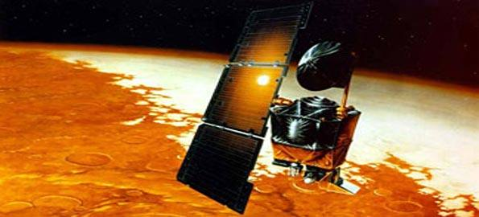
NASAs metric confusion caused Mars orbiter loss
NASA lost a 125 million Mars orbiter because one engineering team used metric units while another used English units for a key spacecraft operation, according to a review finding released Thursday.--CNN

Slide 12
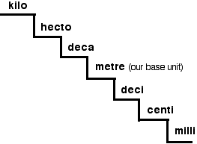
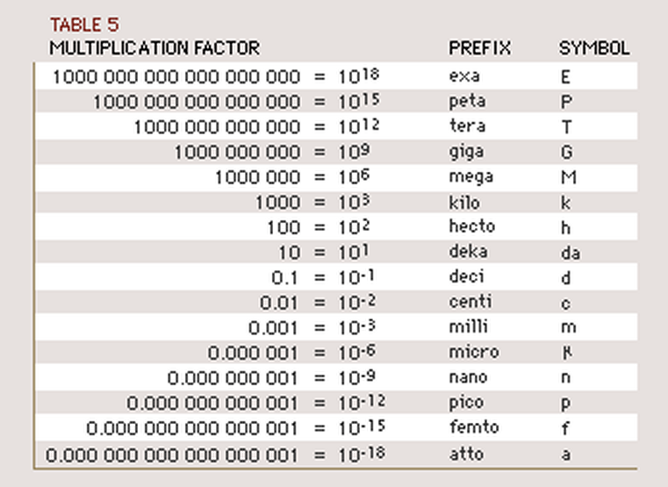
Metric Prefixes

Slide 13
Practice
Convert the following:
How many meters are in 24 kilometers?
How many grams are there in 36 miligrams?
How many miliseconds are there in 3 hectoseconds?
How many miligrams are there in 8 decimeters?
24,000 meters
0.036 grams
300,000 miliseconds
?????????

Slide 14
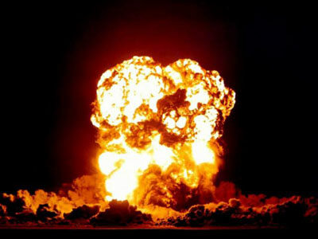
Unit Conversion
Can you add
12ft + 3yrd + 24in =
39 ftyrdin ??????
This type of logic can only result in…
You must convert the units!
Pick something that everything can easily convert into and then add
3yrd = 9 ft
24in = 2ft
12ft + 9ft + 2ft =
23 ft ☺

Slide 15
The train track method
Lets say we need to turn 13.1 miles into inches. How would we do it?
Always start with what you’ve been given
Then map your way to the unit you want
13.1 mi
5280
ft
12
in
830,016 in
1
mi
1
ft

Slide 16
Practice
How tall are you in meters?
How tall are you in ears?
How many hours old are you?

Slide 17
Practice
The new field is 1.6 miles long. What would that be in kilometers?
1.6 mi
ft
in
cm
m
km
mi
ft
in
cm
m
2.57 km

Slide 18
Double Conversion
What do we do if we have a mixed unit?
Speed limit is 15 m/s and I need to know what it is in mi/hr…..
Convert the top unit first and then the bottom unit
15 m
3.28
ft
1
mi
60
s
60
min
s
1
m
5280
ft
1
min
1
hr
33.5 mi/hr

Slide 19
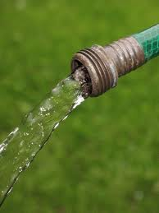
Practice
If my hose sprays out 10 gallons per minute, How many liters per second would that be?
0.63 liters/second

