Slide 1
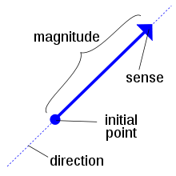
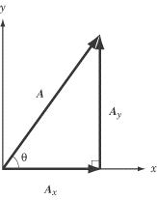
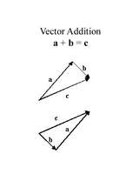
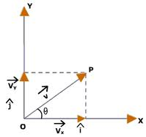
Vector Mathematics

Slide 2
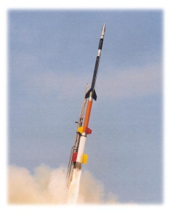
Basic Addition and Subtraction
This is far from rocket science, but without it we could never launch rockets!
+
=
5 m
3 m
8 m
-
=
5 m
3 m
2 m
* a negative sign means to flip the vector!
+
=
5 m
3 m
2 m

Slide 3
??????????
What if the vectors look like this?
5 m
7 m
+
=
ANYTIME the vectors are placed on an angle,
you must find the components!!!!!!!!

Slide 4
Components
5 m
+
7 m
=
We need an angle!!
5 m
7 m
y component
y component
$$23°$$
76$°$
x component
x component
Angles are not to scale
☺

Slide 5
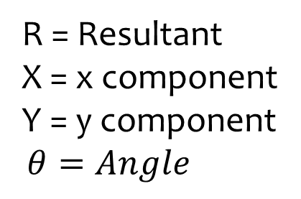
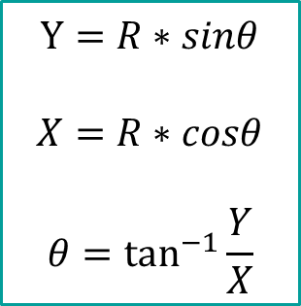
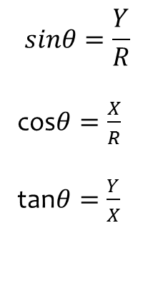
A quick Trig Review
Angle must come from the horizontal for these to work
R = Resultant
X = x component
Y = y component
$$θ=Angle$$
Do not be
Afraid!!!
These are just
buttons on the
calculator
R
Y
$$θ$$
X
SOH CAH TOA
Pythagorean Theorem
$$sinθ=\frac{Y}{R}$$
cos$θ=\frac{X}{R}$
tan$θ=\frac{Y}{X}$
$$Y=R∗sinθ$$
$$X=R∗cosθ$$
$$θ=\tan^{−1}{\frac{Y}{X}}$$
$$R^{2}= X^{2}+ Y^{2}$$
Lets make
one change
$$R=\sqrt{X^{2}+ Y^{2}}$$

Slide 6
Components
Angles are not to scale
☺
5 m
7 m
+
We need an angle!!
5 m
7 m
+
$$23°$$
76$°$
Find the components
Y = 5*sin(23) = 1.953m
X = 5*cos(23) = 4.602m
Y = 7*sin(76) = 6.792m
X = 7*cos(76) = 1.693m

Slide 7
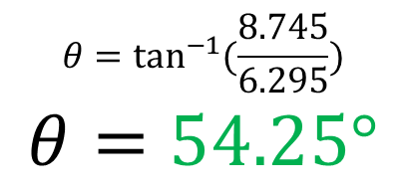
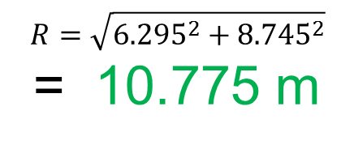
5 m
7 m
+
76$°$
$$23°$$
Y = 5*sin(23) = 1.953m
X = 5*cos(23) = 4.602m
Y = 7*sin(76) = 6.792m
X = 7*cos(76) = 1.693m
Y
1.953 + 6.792 =
8.745 m
$$R=\sqrt{{6.295}^{2}+{8.745}^{2}}$$
= 10.775 m
$$θ=\tan^{−1}{(\frac{8.745}{6.295})}$$
$$θ=54.25°$$
X
4.602 + 1.693 =
6.295 m

Slide 9
Practice
10 m
3 m
12 m
+
+
$$45°$$
$$15°$$
y = 0 m
$$y=3∗\sin{45}=2.121 m$$
$$y=12∗\sin{15}=3.105 m$$
x = 10 m
$$x=3∗\cos{45=2.121 m}$$
$$x=12∗\cos{15=−11.59 m}$$
5.226
Y = 0 + 2.121 + 3.105 = 5.226 m
$$R=\sqrt{{0.531}^{2}+{5.226}^{2}}=5.252 m$$
X = 10 + 2.121 – 11.59 = 0.531 m
$$θ=\tan^{−1}{(\frac{5.226}{0.531})}=84.19°$$
0.531

Slide 10

Find the Components of the Vector
X
$$39°$$
Now you can use your short cuts
Is the X component
X=15cos(51)
???????????
$$51°$$
NO!!!!!!!!!!!
$$X=15\cos{39}$$
15 m
You must first change the angle so that is comes from the horizontal axis!
$$Y=15\sin{39}$$
$$90−51=39$$
Y

