Slide 1
Bell Ringer
Solve using acceleration:
How far will an object at rest go in 10 seconds if it accelerates at 4 m/s/s
What is the acceleration of an object that starts at rest that goes 50 meters in 10 second?
How long does it take an object to go 45 meters if it has an acceleration of 8m/s/s?

Slide 2
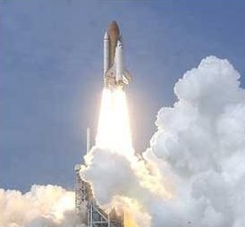
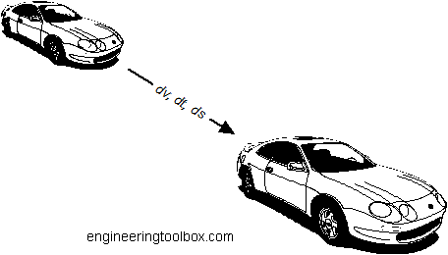
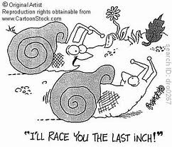
Acceleration

Slide 3
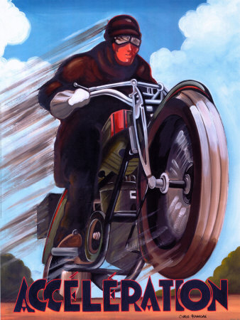
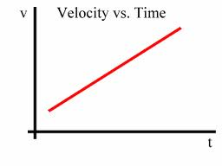
Acceleration
Magnitude
Change in VELOCITY!!!
or
Direction
Need an equation
If slope is a rate of change, then what type of graph do I need to make an equation for acceleration?
Review
y=mx+b
x
x=vt+xi
Slope = velocity
xi
t
What is slope?
Shows a Rate of Change

Slide 4
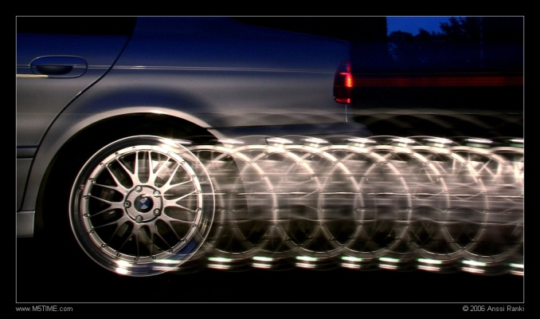
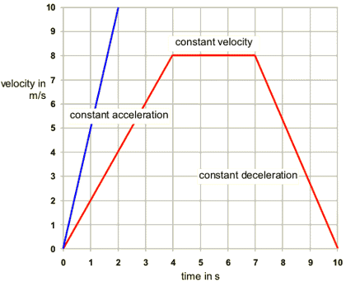
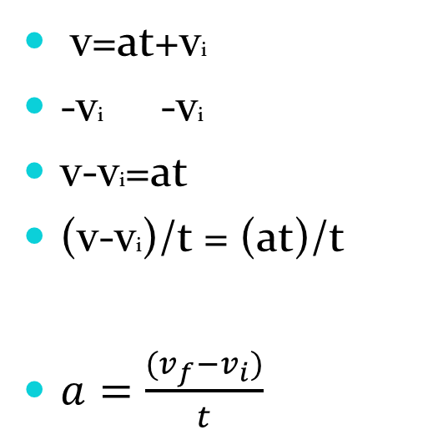
Acceleration
v=at+vi
-vi -vi
v-vi=at
(v-vi)/t = (at)/t
$a=\frac{(v_{f}−v_{i})}{t}$
v
Slope =
accelaration
vi
t
y = m x + b
v
=
a
t
+
vi

Slide 5
Acceleration and Units
m/s
Units =
What do the units mean?
s
5 mi/hr :
For every hour of travel you move 5 miles.
12 (km/hr) / s :
For every second of travel your speed changes by 12 km/hr.
Units always have a story to tell and that is why they are so important!

Slide 6
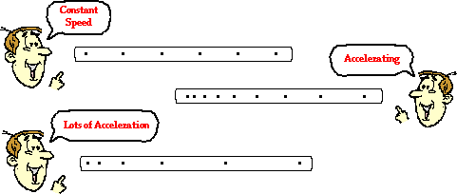
Acceleration and Units
So if my speed increases by constant increments of 15 m/s each second, how does that affect the distance I travel?
15 m/s²
The distance between points is NOT! constant. We travel greater distances because of our increasing speed.
v=15m/s
v=0m/s
v=30m/s
v=45m/s
v=60m/s

Slide 7
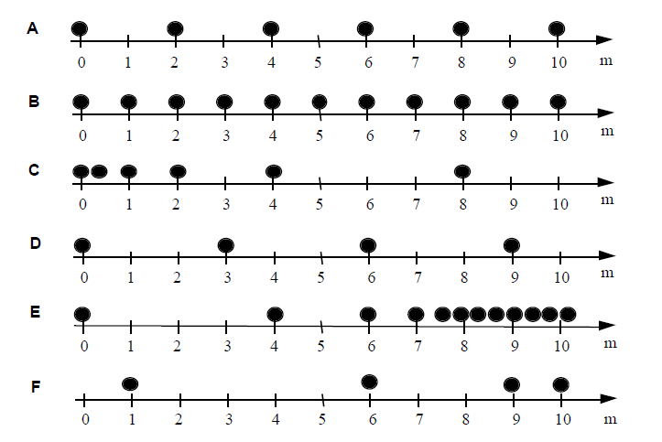
Rank from least to greatest acceleration

Slide 8
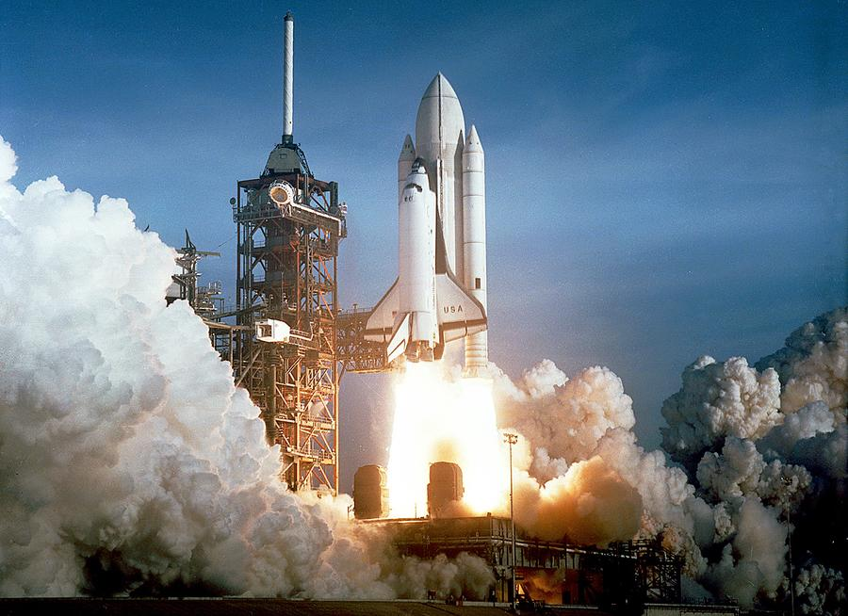
Practice
From 1981 to 2011 we used the Space Shuttle to take people and cargo to space. The Space Shuttle can accelerate at a rate of 15.8 m/s². It can only enter Earth’s orbit if it reaches a velocity of 8,055 m/s or else it will fall back down to Earth. How long does it take for the Space Shuttle to reach full velocity?
a = (vf-vi)/t
15.8 = (8,055-0)/t
t = 8,055/15.8
t = 509.8 s = 8.5 min

Slide 9
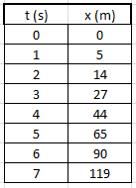
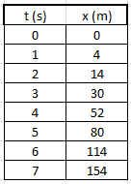
Using tables to find acceleration
What is the position of the first object for the 8th second?

Slide 10
What will the velocity vs. time and acceleration vs. time graphs look like?

Slide 11
What will the position vs. time and acceleration vs. time graphs look like?

Slide 12
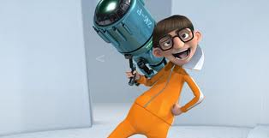
Vectors
Magnitude and Direction
#
+ , -
 | + | -
Displacement
In front of start place
Behind of start place
Velocity
Moving Forward
Moving Backward
If v+, then speeding up
If v-, then slowing down
If v+, then slowing down
If v-, then speeding up
Acceleration
v+
v-
a-
=
Slowing down
a-
=
Speeding up

