Slide 1
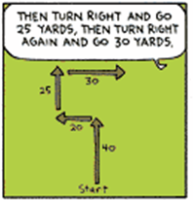
Bell Ringer
What is the distance of the picture shown at the left?
What is the displacement of the picture shown at the left?
65.76yd QI

Slide 2
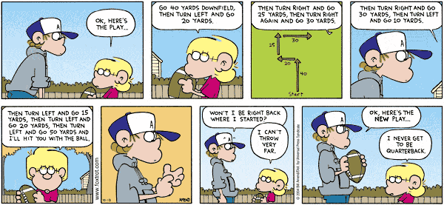

Slide 3
Science Matters
Asteroids

Slide 4
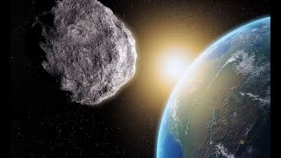
Florence: Largest asteroid in century to safely fly by earth
Fly by at a distance of 4.4 million miles
Moon = ¼ million miles
Mars = 225 million miles (at closest)

Slide 5
Detect asteroids years in advance
Protect against asteroids using missiles, asteroid redirect program, etc.
Only for big ones

Slide 6
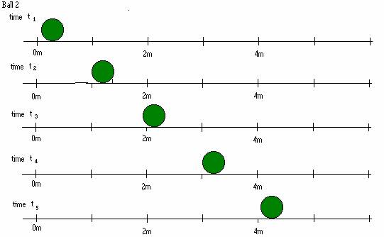
One Dimensional Motion

Slide 7
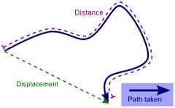
Measuring your Position
Distance (d)
Length of the path travelled
The number of steps you take
Displacement (D)
How far are you from where you started?
(Straight line distance)
D = x_{f} - x_{i}
When are these quantities the same?
When are these quantities different?
Units:
Meters (m)

Slide 8
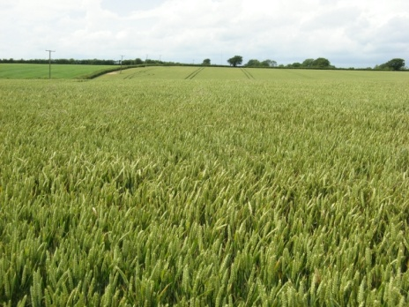
Practice
Jimmy was lost in a field, he found a bottle labeled “drink me” and then proceeded to stager around the field following this pattern: he travel 12m north, 8 m south, 5m east, 20m north, and finally 5m west.
What distance did he travel?
What was his final displacement?
d= 12+8+5+20+5=
50m
D=
5m
8m
=
20m
24m
5m
12m

Slide 9
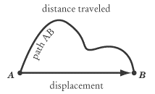
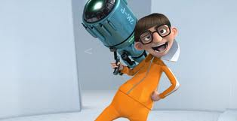
SPEED VS. VELOCITY
Distance
Scalar
magnitude, or just a number
Displacement
Vector
magnitude and direction
Notes:
What are some examples scalar quantities? What are some examples of vector quantities?

Slide 10
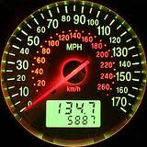
Speed (s)
Average Speed
S_{avg} = d/t
Scalar!!!!
Velocity (v)
Average Velocity
v_{avg}= D/t
= (xf – xi)/t
Vector!!!!
Units: m/s

Slide 11
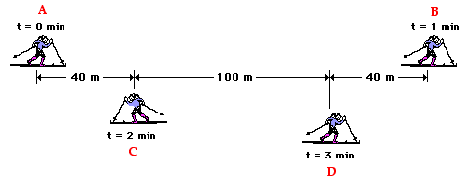
Practice
Average speed from A-B?
Average speed from A-C?
Average speed from A-D?
Average velocity from A-B?
Average velocity from A-C?
Average velocity from A-D?

Slide 12
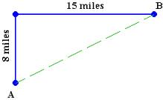
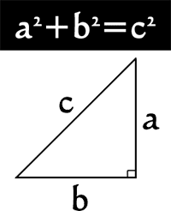
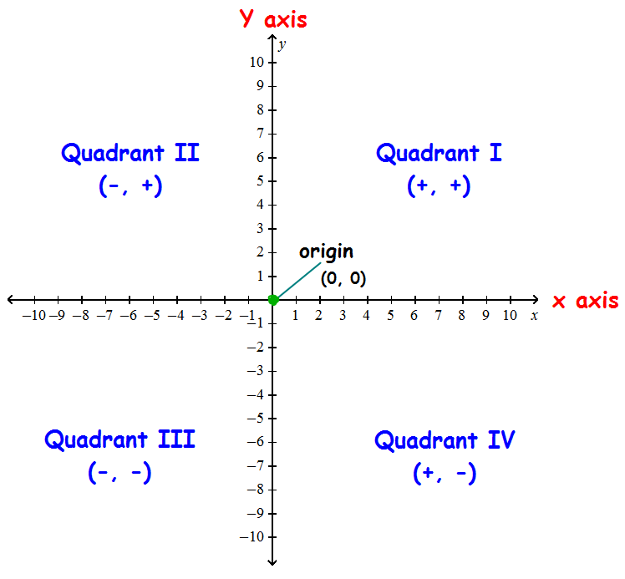
The runner covered the 8 miles in 1 hour and the 15 miles in 3 hours.
Total distance? Final displacement?
Average speed? Average velocity?
Notes:
Distance: 23 miles; Displacement: 17 miles; Average speed: 5.75 mph NOT 6.5; Average velocity: 4.25 mph

Slide 13
Practice
Jimmy jogs the following path to get to school each day. If it takes Jimmy 25 minutes to get to school, what is his average speed and velocity?
120 m
s=d/t
s=(120+50+50+60+150)/(25*60)
50 m
=0.28 m/s
50 m
v=D/t
= 246/(25*60)
X: 120-50+150 = 220m
= 0.164 m/s QIV
Y: 50+60 = 110m
60 m
220
150 m
110
=246 m

Slide 14
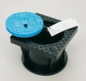
Practice
Jane is frantically shopping for a well cover. She runs down one long aisle, covering the first 25m at 2 m/s and the next 30 m at 3 m/s. She finds the cover after sprinting to the end of the aisle at 5 m/s for the final 10m.
How long does it take Jane to find the cover?
Draw a position vs. time graph that describes Jane’s search.
What is Jane’s average speed from start to finish?
x
t=d/s 25m/(2 m/s) = 12.5 s
65
slope=5
t=d/s 30m/(3 m/s) = 10 s
55
t=d/s 10m/(5 m/s) = 2 s
slope=3
t = 12.5 + 10 + 2 = 24.5 s
25
slope=2
S = d/t =
12.5
22.5
24.5
t

Slide 15
Average & Instantaneous
Average vs. Simple Average of Speed or Velocity
Simple average
Add all numbers, divide by # of numbers
Physics average
Distance or Displacement divided by time
Average vs. Instantaneous
Instantaneous
At a single INSTANT in time. How fast am I going right NOW?
Speeding Ticket
Average
Over a period of time. How fast have I been going? Speed monitored by aircraft.
The runner covered the 8 miles in 1 hour and the 15 miles in 3 hours.

Slide 16
Average & Instantaneous
x
Average vs. Instantaneous
Instantaneous
At a single INSTANT in time
What was Jane’s velocity at 10 seconds?
What was Jane’s velocity at 24 seconds?
Why are they different?
What was Jane’s average velocity from 12.5 s to 24.5 s?
65
slope=5
55
slope=3
25
slope=2
12.5
22.5
24.5
t

Slide 17
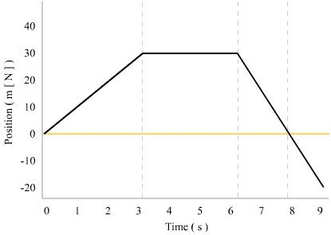
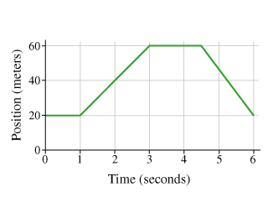
Practice
Notes:
What is the total distance traveled? What is the final displacement? What is distance/displacement for a certain time interval? Where is the object going forwards? When is the object going backwards? When is the object standing still?

