Slide 1
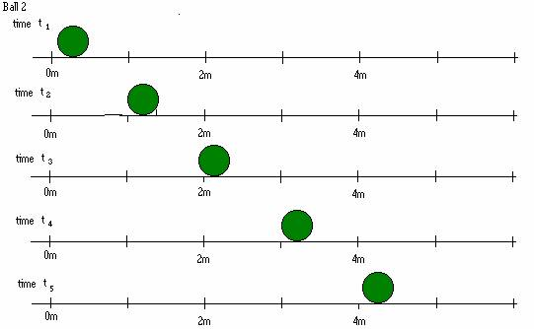
One Dimensional Motion

Slide 2
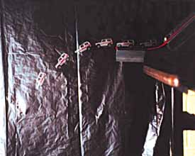
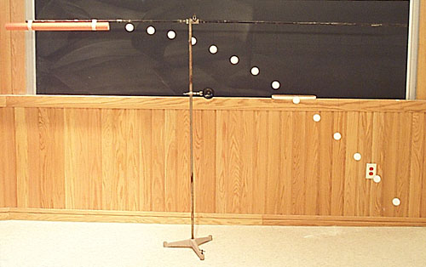
What is the most basic way to describe an object’s motion?
Position
A description of an object’s location

Slide 3
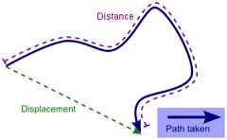
Measuring your Position
Distance (d)
The number of steps you take … How far did you go?
Displacement (D)
How far are you from where you started?
(Straight line distance)
D = x_{f} - x_{i}
When are these quantities the same?
When are these quantities different?
Units:
Meters (m)

Slide 4
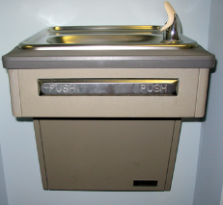
Practice
What distance does Jimmy travel?
What is Jimmy’s final displacement?
17m
-3m

Slide 5
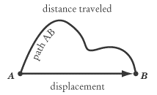
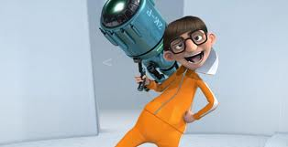
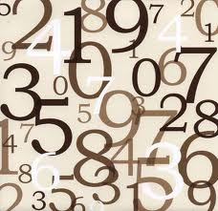
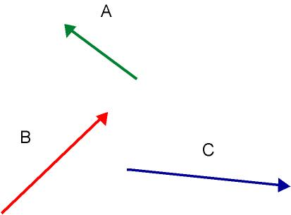
Distance
Scalar
magnitude, or just a number
Displacement
Vector
magnitude and direction

Slide 6
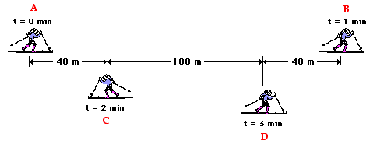
Practice
Total distance? Final displacement?

Slide 7
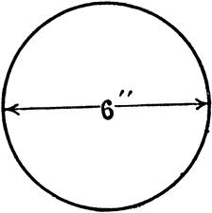
If an ant goes around the circle 3 times, what is your total distance and final displacement?

Slide 8
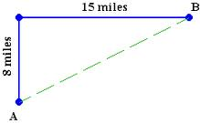
Total distance? Final displacement?

Slide 9
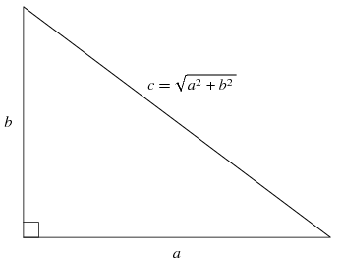
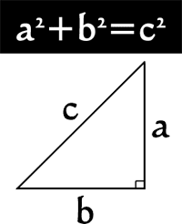
Pythagorean Theorem

Slide 10
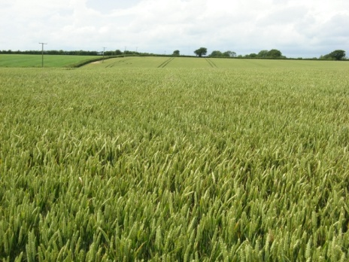
Practice
Jimmy was lost in a field, he found a bottle labeled “drink me” and then proceeded to stager around the field following this pattern: he travel 12m north, 8 m south, 5m east, 20m north, and finally 5m west.
What distance did he travel?
What was his final displacement?
d= 12+8+5+20+5=
50m
D=
5m
8m
=
20m
24m
5m
12m

Slide 11
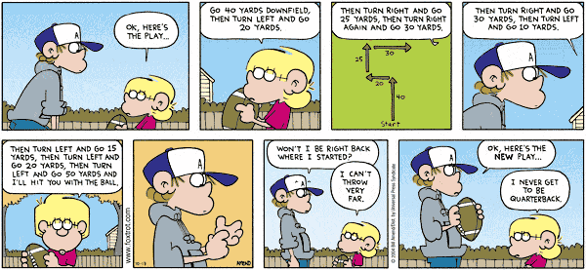

Slide 12
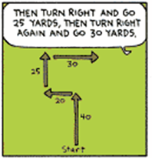
We need to build a triangle
we can work with!!
First: combine all the up and down vectors
Second: combine all the left and right vectors
Now build your triangle and put the
Pythagorean Theorem to good use!
30
10
20
25
=
65
40
65.76yd

Slide 13
Basics Graphs
X
X
t
t
X
X
t
t

Slide 14
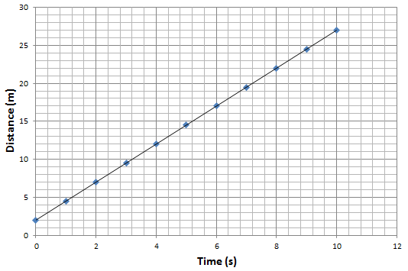
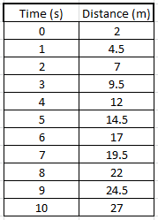
Graphing and Using data
What does the slope mean?
What does the y-intercept mean?
Can I write an equation for this line?

Slide 15
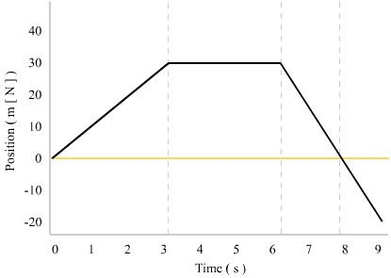
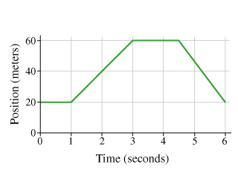
Practice

