Slide 1
Bell Ringer
Name three types of forces and what they do.

Slide 2
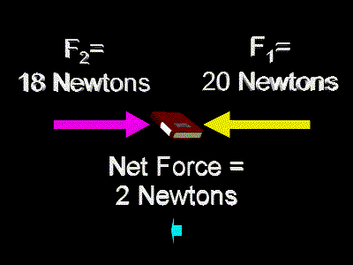
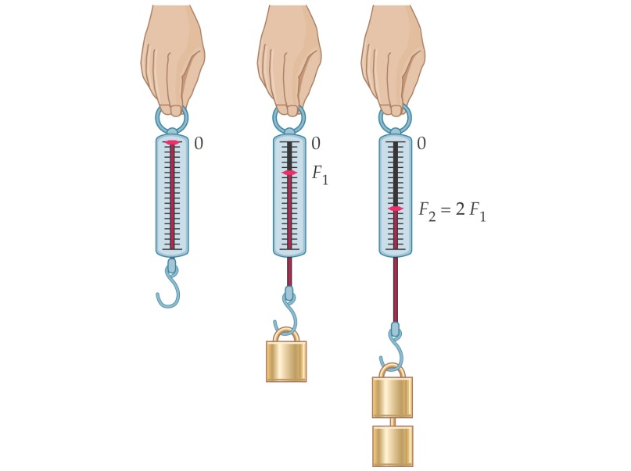
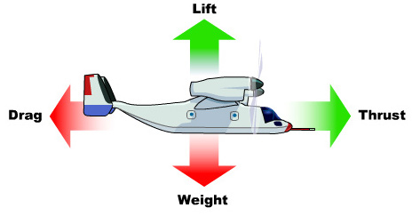
Forces

Slide 3
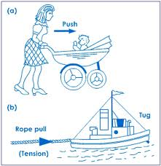
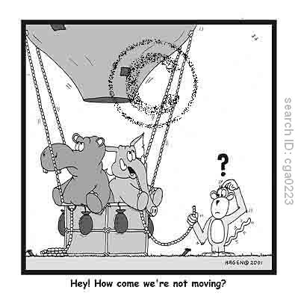
Basic Definition for Force
Force is most easily defined as a:
PUSH or a PULL
Units: N (Newtons)

Slide 4
Purpose of Forces
To change an object’s state of motion!!!

Slide 5
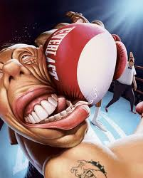
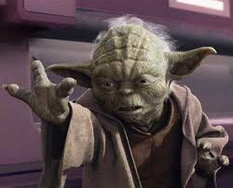
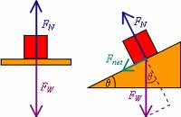
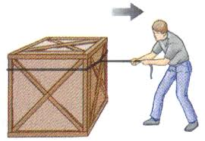
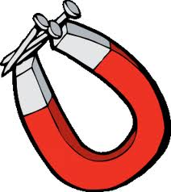
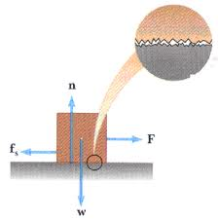
Understanding Forces
Contact:
Normal Force
Tension
Friction
Non-contact:
Gravity
Electromagnetic

Slide 6
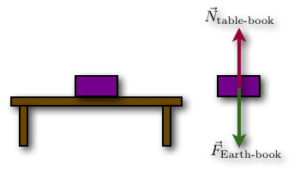
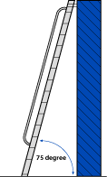
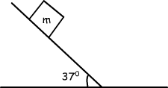
Normal Force
A support force
--It supports the weight of things
Direction:
Always!!!!! Perpendicular to the surface

Slide 7
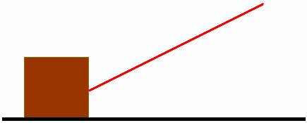
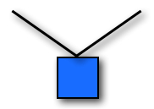
Tension
Forces in Ropes and Strings
Direction:
Follows the rope or string

Slide 8
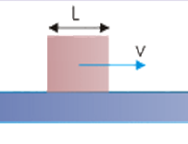
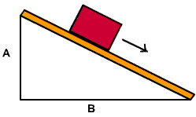
Friction
Force that resists motion
Direction:
Opposite the motion of object
Parallel to surface

Slide 9
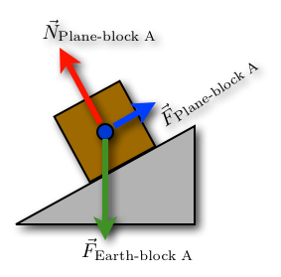
Force Diagrams!!!!
We use these to analyze the forces acting ON an object
To make a force diagram you follow three simple steps:
1. Replace the object with a dot
2. Draw the Non-contact forces
---For now we will only be using gravity
3. Draw the Contact forces
---Answer the question:
“What is touching the object?”

Slide 10
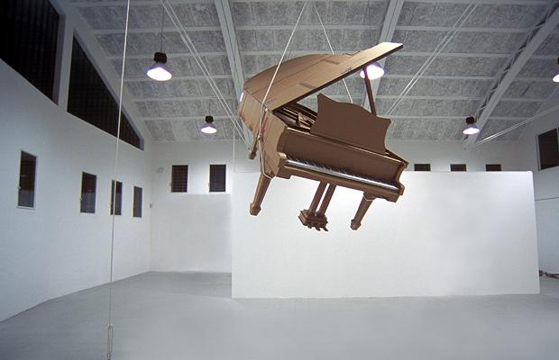
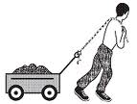
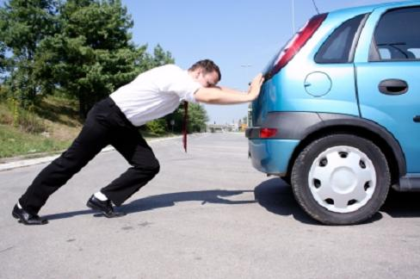
Practice
T
T
N
For the piano
Fg
For the wagon
Ff
N
Fg
Ff
Fp
For the car
Fg

