Slide 1
Bell Ringer
A rocket takes off at an acceleration of 13 m/s/s, and it needs to reach a height of 30,000m to make orbit. It only has one minute of fuel. Can it make orbit?
A car speeds down the freeway at 100 mph, but then suddenly sees a cop. He decelerates at 5 mph/s but only has five seconds before the cop detects him. Will he get a ticket?
What is the acceleration for the following chart?
Time (s) | Position (m)
0 | 5
1 | 10
2 | 17
3 | 26
4 | 37

Slide 2
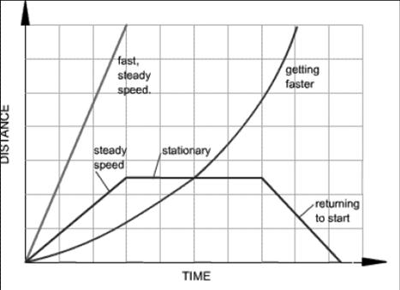
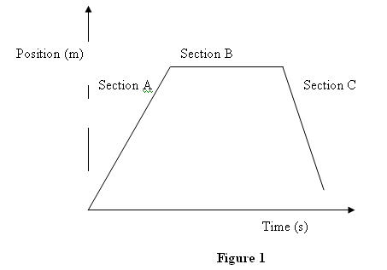
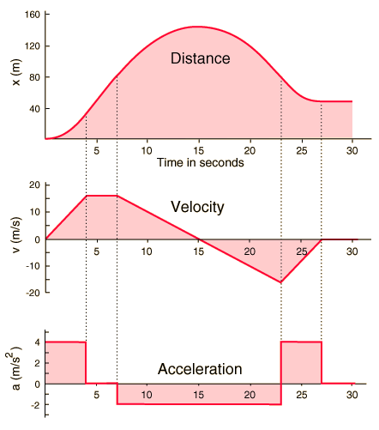
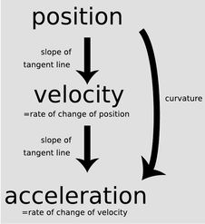
Graphing and Motion

Slide 3
Understanding graphs of motion
x
What does slope mean?
--Rate of change
--The slope of a position
graph is :
Velocity!!!
v
What does slope mean?
--Rate of change
--The slope of a velocity
graph is
Acceleration!!!
a
slope=
0
slope=
0
t
t
t
x
slope=
a
+
constant
v
slope=
0
t
t
t
x
v
a
slope=
-
constant
t
t
t
slope=
0

Slide 4
Understanding graphs of motion
slope=
+
x
v
a
slope=
+
t
t
0
t
slope=
slope=
0
x
v
a
slope=
-
t
t
t
slope=
-
x
v
value =
+
a
What do these values
tell us about the slope?
value =
0
t
t
Connect the line segments
with a curve
t
value =
-

Slide 5
Practice
Draw the Velocity vs. Time graph that matches the shown graph:
Slope
0 m/s
X (m)
Slope
6m/3s =
2 m/s
Slope
-4m/1s =
-4 m/s
Slope
3m/3s =
1 m/s
1 m
Slope
0 m/s
t (s)
2s

Slide 6
Practice
V (m/s)
What would the acceleration graph look like for this?
1 m/s
t (s)
2s

Slide 7
Practice
Draw the Velocity vs. Time graph and the Position vs. Time graph if your velocity follows these patterns:
Assume you start at x = 0m
t = 0 – 5s t = 5 – 10s t = 10 – 15s v = -4 m/s v = 2 m/s v = 3 m/s
x = -20 m
x = 10 m
x = 15 m
+
+
x (m)
V (m/s)
x = -10 m
x = 5 m
5 m
t (s)
t (s)

Slide 8
Vectors and motion
What does a vector look like?
Magnitude = Length of Vector
Direction = Shown by the Arrow
5 m/s
10 m/s
1 s
1 s
8 m/s
6 m/s
4m/s
-2 m/s²
-2 m/s²
-2 m/s²
20s
…
-32m/s
-2 m/s²

Slide 9
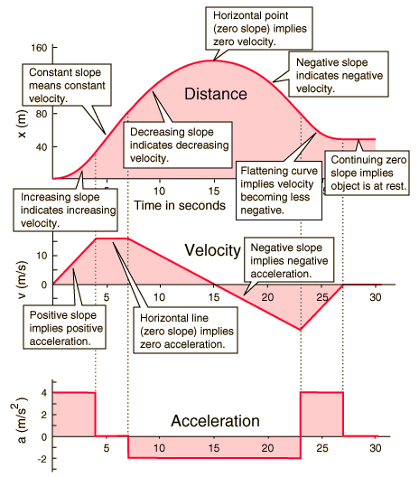
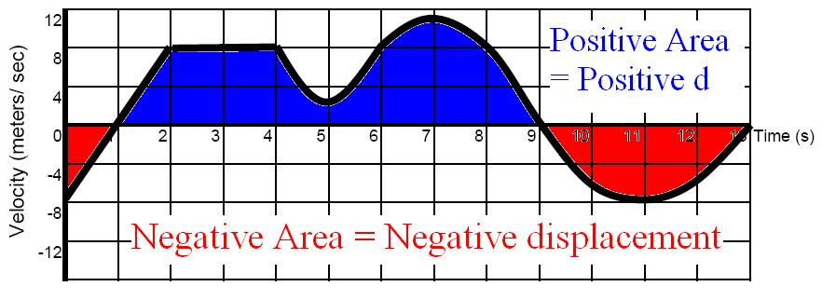
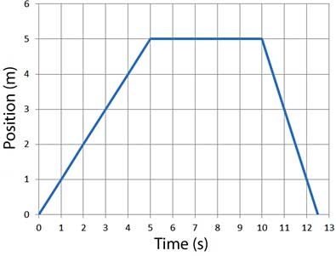
Area Graphing

Slide 10
Draw the Velocity vs. Time graph that matches the shown graph:
Practice 1
X (m)
Slope
0 m/s
Slope
-4m/3s =
-1.33 m/s
Slope
6m/3s =
2 m/s
Slope
-4m/2s =
-2 m/s
Slope
2m/2s
1 m/s
t (s)

Slide 11
Practice 1
What would the acceleration graph look like for this?
V (m/s)
t (s)

Slide 12
What would the Position graph look like for this velocity graph?
Practice 2
v (m/s)
$$x_{f}=x_{i}+\frac{1}{2}\left(v_{f}+v_{i}\right)t$$
x
xi =
xf =
vi =
vf =
a =
t =
x
xi = 0
xf = ?
vi = 0
vf = -3 m/s
a = -1 m/s²
t = 3s
$$x_{f}=0+\frac{1}{2}\left(−3+0\right)3$$
$$x_{f}=−4.5m$$
6 m/s for 5 s
=
30 m
$$x_{f}=x_{i}+\frac{1}{2}\left(v_{f}+v_{i}\right)t$$
x
xi = 0
xf = ?
vi = 6 m/s
vf = 0 m/s
a = -6/4 m/s²
t = 4s
-3 m/s for 4 s
=
-12 m
x
xi =
xf =
vi =
vf =
a =
t =
0 m
t (s)
$$x_{f}=0+\frac{1}{2}\left(0+6\right)4$$
$$x_{f}=12m$$
30m + 12m + 0m – 4.5m -12m
=
25.5m

Slide 13
What would the Position graph look like for this velocity graph?
Practice 2
v (m/s)
There is one other way to do this
If you want to go from a velocity graph back to position, you can use the AREA under the line!
½*6*4
=
12m
6*5
=
30m
½*-3*3
=
-4.5m
-3*4
=
-12m
B*H
½*B*H
0m
t (s)
30m + 12m + 0m – 4.5m -12m
=
25.5m

Slide 14
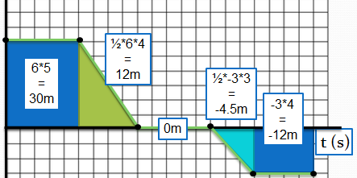
Practice 2
Lets say that the initial position is
x = -10m
x (m)
+0
-4.5
+12
When the velocity is constant the slope is constant
-12
5m
25.5m
t (s)
When the velocity changes, the slope of the position graph changes or it curves
+30

Slide 15
SLOPE
Practice 3
P V A
AREA
a (m/s²)
6m/s + 0m/s – 4m/s
=
2 m/s
What does the velocity and position graph look like for this acceleration graph?
2*3
6 m/s
0 m/s
t (s)
-1*4
-4 m/s

Slide 16
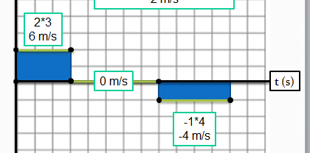
SLOPE
Practice 3
P V A
AREA
Assume the initial velocity is 0 m/s
v (m/s)
+0
Assume the initial position is -30 m
-4
+6
2 m/s
t (s)
½*6*3
=
9m
6*5
=
30m
½*4*4
=
8m
2*4
=
8m
16 m
9m + 30m + 16m
=
55 m

Slide 17
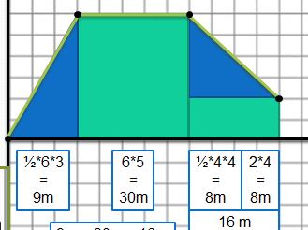
SLOPE
Practice 3
P V A
AREA
x (m)
Lets say that the initial position is
x = -30m
+16
5m
55 m
t (s)
+30
+9

