Slide 1
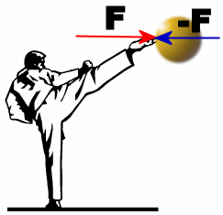
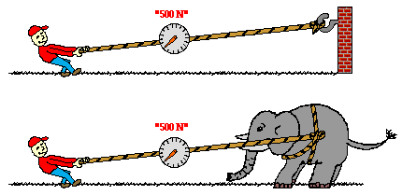
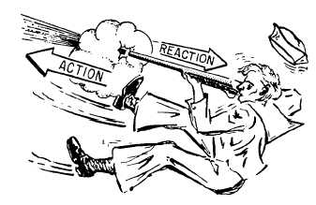
Newton’s Third Law

Slide 2
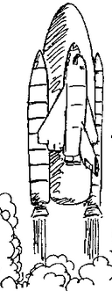
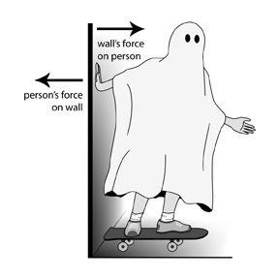
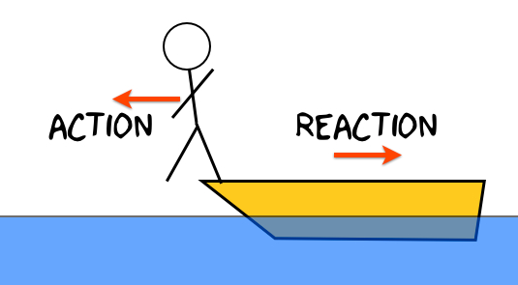
Newton’s Third Law
All Forces come in EQUAL and OPPOSITE pairs!
What does that mean?

Slide 3
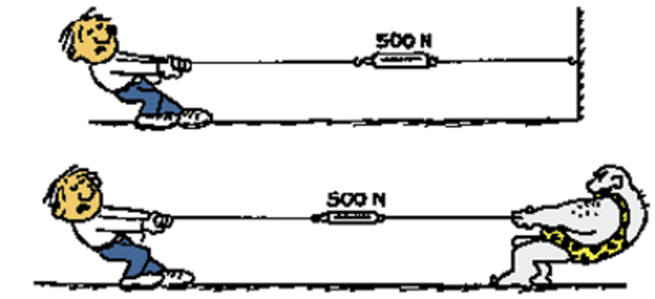
Newton’s Third Law
Notes:
How hard are the objects pulling? Animate vs. inanimate, source of the force

Slide 4
Paired Forces
Forces are paired if they are:
Equal
Opposite directions
Same type of force
Act on different objects
Notes:
Non-example of gravity and the normal force

Slide 5
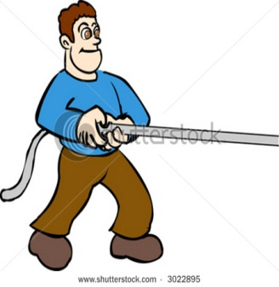
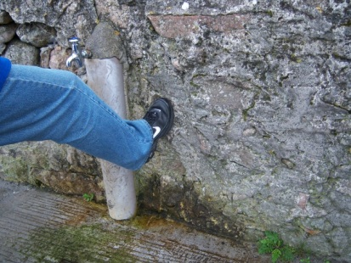
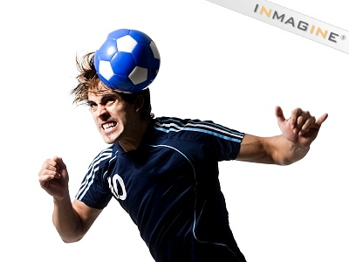
Practice
I pull on the rope
the rope pulls on me
I kick the wall
the wall kicks me
My head hits the soccer ball
The soccer ball hits my head

Slide 6
Practice
If a gun shoots a bullet forward, then the bullet will also shoot the gun _______.
If the Earth pulls a skydiver DOWN with its gravity then _______.
If Jimmy’s foot pushes a soccer ball forward with 20 N of forces, the soccer ball _______.
If a tow truck pulls a car forward with 1200 N of force then the car _________.
If a magnet pulls a paper clip up with 2 N of force, then the paperclip __________.
If Bob’s teeth pushes in on a metal nail with 50 N of force, then the nail________.
Bob is trying to do a pull up on a bar. If Bob pulls down on the bar with 700 N of force, then _______.
Bob is trying to do a push up. If Bob pushes down on the floor with 400 N of force, then ________.

Slide 7
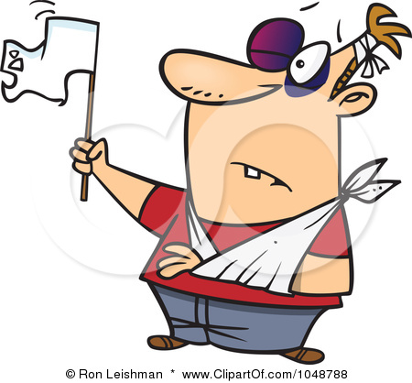
Perspective

Slide 8
I did not provoke the fight, so I do not feel bad for what I was forced to do. We were arguing, and since I was right and he was wrong, he decided to fight to cover up his stupidity. He swung at me first, but because I was in top physical condition, I was able to act quickly and block the punch neatly with my head. Then, I jumped to the ground, knocking him down on top of me. I placed my ear in his mouth and between his teeth and then I poked his finger several times with my eye. His teeth hurt so much from the strength of my ear that he became irate and tried to kick me, but I cleverly blocked the onslaught of his attack with my ribs and face. I scrambled to my feet and ran to my car in hopes I would get away and save this man from my deadly hands. Before I could start the car he pulled me from the open door. I proceeded to swing at him, but only managed to hit myself in the head. To this I said, “What’s this two against one?” That was the final straw—I lost all control. There will be no mercy!! Taking him in my death grip, I pounded him in the knee with my stomach—then I hit him two or three times in the fist with my teeth! He had had it! I could tell. After that he didn’t even try to pick me up off the ground. He was too chicken!!

Slide 9
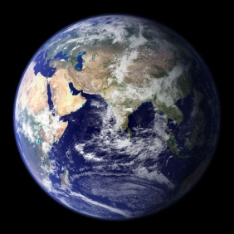
The Force of Gravity pulls an apple to the Earth
The force of Gravity pulls the Earth to the apple!!!!!!!!!
M
a
Earth
Apple
F
a
=
=
m
The Earth pulls on the apple just as hard as the apple pulls on the Earth!!!!!!
So why does apple move and Earth stand still?
$$F_{net}=ma$$
Notes:
Contast with falling at the same rate???

Slide 10
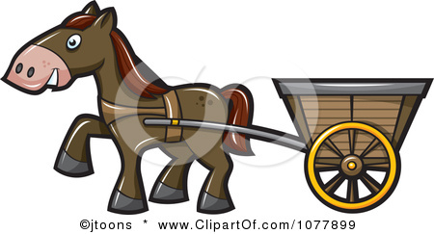
How can the Horse pull the Cart?
We always look at the forces acting ON an object!
T
=
T
Ff
The Ground pushes forward on the Horse!!

Slide 11
Newton’s Third Law in Action
How much force is acting between the blocks?
24 kg
15 kg
12 N
7 kg
F1
F2
To solve this we first start by looking at the problem in a different light,
This is same as….
46 kg
All the blocks move together so they have the same acceleration and can be treated as the same object!!
12 N

Slide 12
46 kg
12 N
With the situation looking like this, we can easily apply Newton’s second Law
$$F_{net}=ma$$
$$12=46a$$
a = 0.26 m/s²
24 kg
15 kg
12 N
7 kg
F1
F2
F1
12 N
F2
F1
F2
$$12−F_{1}=15(0.26)$$
$$F_{1}−F_{2}=7(0.26)$$
$$F_{2}=24(0.26)$$
$$8.1−6.24=7(0.26)$$
$$F_{1}=8.1$$
$$1.8=1.8$$
$$F_{2}=6.24$$

Slide 13
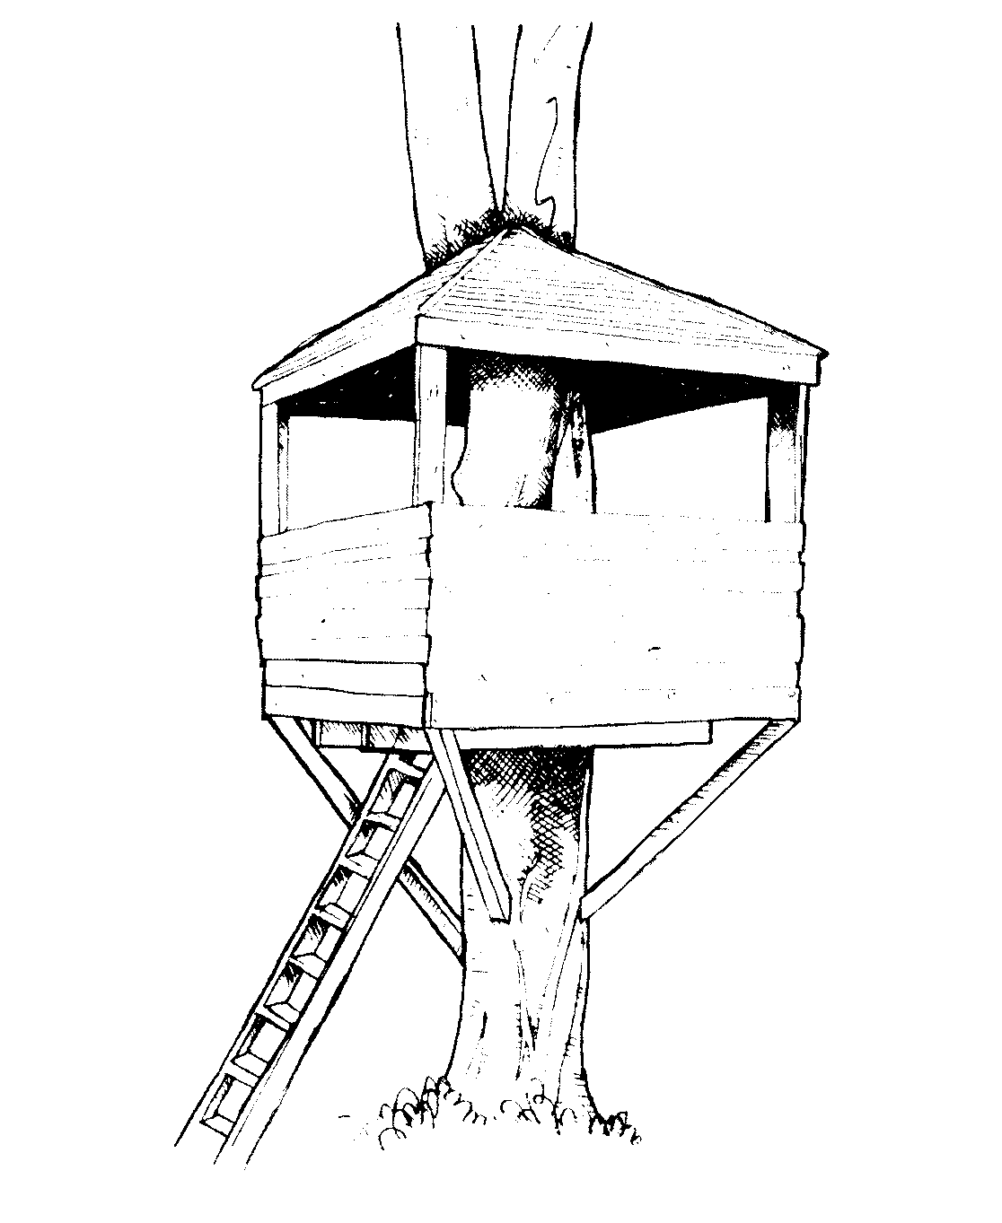
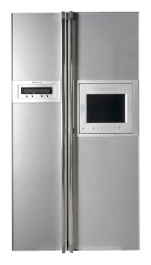
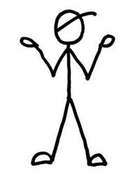
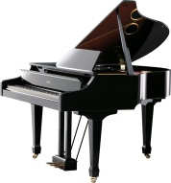
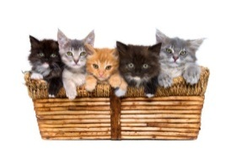
Practice
Jimmy is moving across town and is pushing his belongings down the frictionless street with a force of 125N. What is the force acting between each of the objects and the acceleration?
100 kg
120 kg
52 kg
F1
125 N
F2
F1
F2
125 = (272)a
a = 0.46 m/s²
$$125−F_{1}=100(0.46)$$
$$F_{1}−F_{2}=120(0.46)$$
$$F_{2}=52(0.46)$$
$$F_{1}=79$$
$$79−23.9=120(0.46)$$
$$F_{2}=23.9$$
$$55=55$$

