Slide 1
Bell Ringer
Suppose you are in a car, starting at rest, and accelerate at 5 m/s/s. How far will you go in 10 seconds?
Suppose you start at 10 m/s and accelerate at -2 m/s/s. How far will you go in 8 seconds?

Slide 2
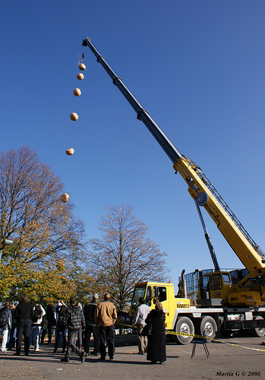
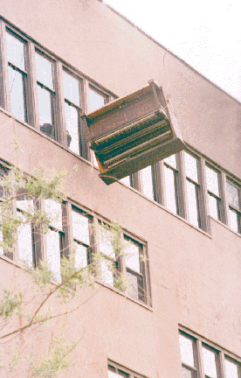
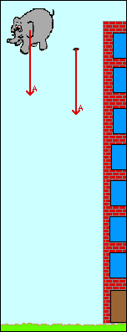
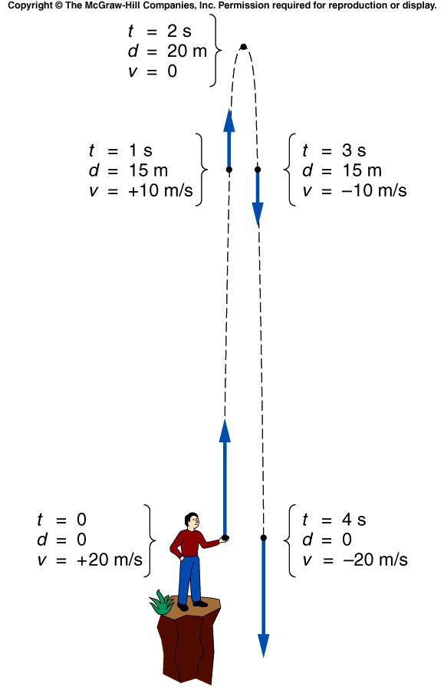
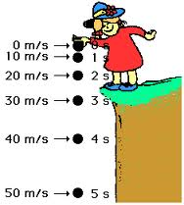
Free fall

Slide 3
When is an object in Freefall?
As soon as it leaves your hand!
When the only force acting on the ball is gravity.

Slide 4
Freefall
If I drop this ball did it accelerate?
What does it mean if I say it accelerated?
Most of us know that when you drop something, it speeds up as it falls. That’s why we would easily catch a baseball that fell one meter with our bare hands but if it fell from a 5 story building?

Slide 5
Acceleration of Gravity --- g
-9.8 m/s²
$$≈−10 m/s^{2}$$
What does this mean?
Gravity changes the speed of an object by -10 m/s each second!!!
If I’m holding a ball in my hand what is the ball’s velocity?
0m/s
As soon as the ball leaves my hand what is the ball’s acceleration?
-10m/s/s
If I throw the ball into the air and it reaches the top what is it’s acceleration?
-10m/s/s
If it starts coming back down, what is it’s acceleration?
-10m/s/s

Slide 6
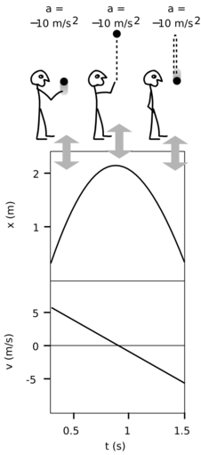
Freefall
What is the difference between an object in free fall and the motion we have been doing all year long?
Nothing really except it is constantly accelerating!
What do the graphs of motion look like for the ball free falling?

Slide 7
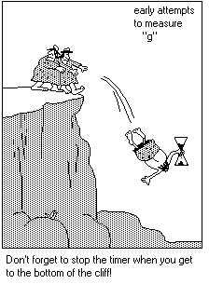
Acceleration of Gravity --- g
-9.8 m/s²
$$≈−10 m/s^{2}$$
What does this mean?
Gravity changes the speed of an object by -10 m/s each second!!!
So, If I throw a ball up into the air at 35 m/s, how fast is it going after 2 seconds?
15 m/s
3 seconds?
5 m/s
4 seconds?
-5 m/s
What happens when the ball gets to the top?
It stops!!
But only for a moment
How long till it gets there?
3.5 seconds
How fast is it going when it gets back to my hand?
-35 m/s

Slide 8
If Jimmy throws a smiley face into the air with an initial velocity of 30 m/s, How fast will it be going one second later?
How fast is the ball traveling if one represents a second of time?
y
yi =
yf =
vi =
vf =
a =
t =
vf = at + vi
0
0 m/s
?
Vf = (-10)(5) + 0
0
Vf = -50 m/s
10 m/s
-10 m/s
?
-10 m/s²
20 m/s
-20 m/s
5 s
How far has it fallen?
30 m/s
-30 m/s
yf = yi + vit + ½at²
Why is this Negative?
yf = 0 + 0 + ½(-10)(5)²
Because it is below where it started!
yf = -125 m

Slide 9
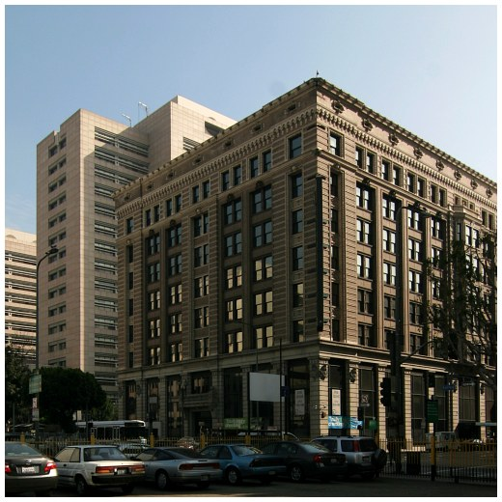
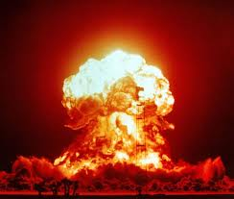
Practice
Jimmy is trying to ambush Jane with a pie…
If the building is 52 meters tall, how fast is the pie going when it gets to her face? Jane is 1.5 meters tall.
y
yi = 0
yf = -50.5
vi = 0
vf = ?
a = -10
t = ?
$${v_{f}^{}}^{2}= {v_{i}}^{2}+2a\left(y_{f}− y_{i}\right)$$
$${v_{f}^{}}^{2}=0+2(−10)\left(−50.5−0\right)$$
$$v_{f}=\sqrt{1010}$$
$$v_{f}=−31.78 m/s$$
$≈$ -72 mi/hr

Slide 10
Get away car
Two men are robbing a bank. One actually steals the money and runs to the roof of the 20 meter tall bank while the other is 100 meters away in a getaway car. At the order of the robber on the roof, the getaway driver begins accelerating at 4 m/s/s towards the bank. How many seconds after giving the order would the robber on the roof have to jump from the building to land on the getaway car?

Slide 11
Get away car
Two men are robbing a bank. One actually steals the money and runs to the roof of the 20 meter tall bank while the other is 100 meters away in a getaway car. At the order of the robber on the roof, the getaway driver begins accelerating at 4 m/s/s towards the bank. How many seconds after giving the order would the robber on the roof have to jump from the building to land on the getaway car?
20m
100m

Slide 12
Get away car
Two men are robbing a bank. One actually steals the money and runs to the roof of the 20 meter tall bank while the other is 100 meters away in a getaway car. At the order of the robber on the roof, the getaway driver begins accelerating at 4 m/s/s towards the bank. How many seconds after giving the order would the robber on the roof have to jump from the building to land on the getaway car?
Xi =
Xf=
Vi =
Vf =
a =
t =
Xi =
Xf=
Vi =
Vf =
a =
t =
20m
100m

Slide 13
Get away car
Two men are robbing a bank. One actually steals the money and runs to the roof of the 20 meter tall bank while the other is 100 meters away in a getaway car. At the order of the robber on the roof, the getaway driver begins accelerating at 4 m/s/s towards the bank. How many seconds after giving the order would the robber on the roof have to jump from the building to land on the getaway car?
Xi = 0
Xf= 20m
Vi = 0
Vf = ?
a = 10 m/s/s
t = ?
Xi = 0
Xf= 100m
Vi = 0
Vf = ?
a = 4 m/s/s
t = ?
20m
100m

Slide 14
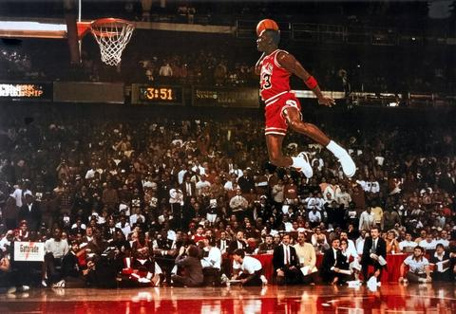
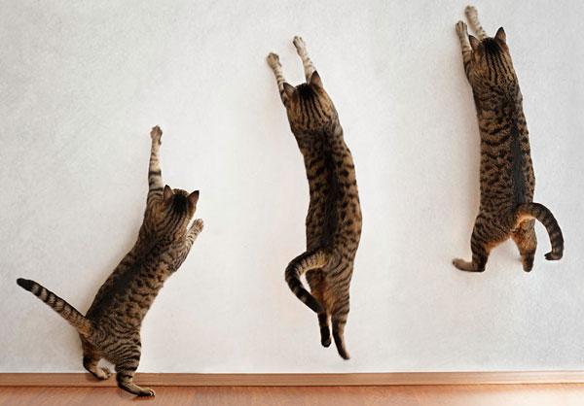
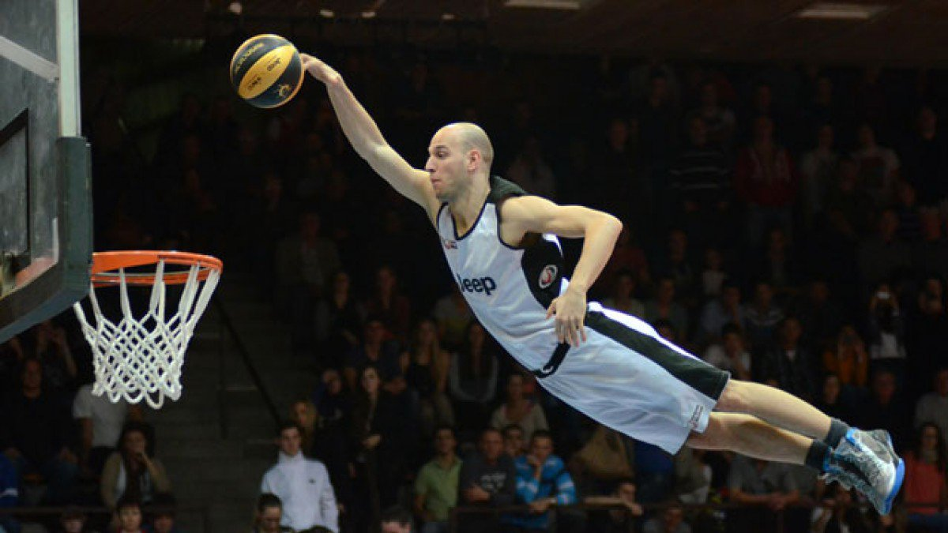
Calculate your personal “hang time”
Time how long you can keep you feet off the ground during a vertical jump!
Use that time to calculate your initial velocity as you pushed of the ground!

Slide 15
Ruler Reaction Time Race Of Science!!!
One person drops the ruler as the other person sees how fast they can catch it.
Then switch and compare who
Best out of three wins.
Each side find their winner and send them to the front!

Slide 16
THE Dollar Drop

