Slide 1
Bell Ringer
Today is Dec. 4th! That means the semester is almost over! List 3 goals you want to accomplish before the end of the year.

Slide 2
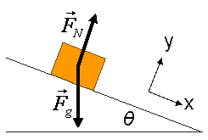
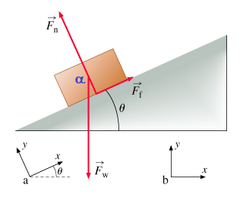
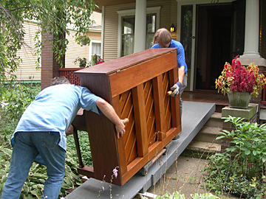
Ramps

Slide 4
So far we’ve done problems on a flat surface
N
Motion
W
What if we start tilting the ramp?
What happens to the magnitude of the Normal Force?

Slide 5
Looking at the extremes
Motion
rough
Motion
N
N
Ff
Motion
W
W
W
What if we start tilting the ramp?
What happens to the magnitude of the Normal Force?

Slide 6
Looking at the extremes
Motion
rough
Motion
N
N
Ff
Motion
W
W
W
Here the N=Fg Here N<Fg Here N=O
max N min N

Slide 7
What is the force that makes an object slide down a ramp?
What force was making the blocks slide down the incline?
Does the force of gravity increase as the angle of the ramp increases?
GRAVITY
The magnitude of gravity is constant, but it has a greater and greater affect on the motion of the block

Slide 8
Motion
rough
Motion
N
N
Ff
Motion
W
W
W
Look at the extremes…When the angle is 0 or 90 degrees.
As the angle increases gravity has a greater and greater effect on the object!
We will see this as we calculate an X and Y comp. for gravity!
0 = Gravity has no effect on motion, 90 = Object is in Free Fall

Slide 9
rough
Motion
When an object was in motion across a flat surface, we used these steps.
Draw a Force Diagram
Break-up the forces into X and Y components
Left = Right
Up = Down
We’ll now do a similar thing for objects on a slant.

Slide 10
Step 1: Draw our force diagram
Step 2: Tilt our force diagram
rough
Motion
What is the direction of motion for the block?
We need to TURN the problem so that this direction of motion is flat!!!
N
Ff
N
Ff
Motion
Motion
W
W
New Diagram
Notes:
Tilt your head, Which way is the normal force….

Slide 11
Step 3: Use angle $φ$instead of $θ$ to find your components.
rough
Motion
N
Ff
$$W∗cos⁡(φ)$$
Motion
$$φ$$
$$W∗sin⁡(φ)$$
Where do I get the angle $(φ)$?
W
$$angle=90−θ=φ$$
Rotated Diagram
If we do this then we don’t need to change the equations we have used to find the components
X Y
$$F_{gx}=Fgcos⁡(φ)$$
$$Fgy=Fg∗sin⁡(φ)$$
Notes:
Now there is a component of gravity that is pulling it down the ramp.
What is the normal force.
Where do I get the new angle
Walk through 4 steps.

Slide 12
Step 3: Use angle $φ$instead of $θ$ to find your components.
rough
Motion
N
Ff
$$W∗cos⁡(φ)$$
Motion
$$φ$$
$$W∗sin⁡(φ)$$
Where do I get the angle $(φ)$?
W
$$angle=90−θ=φ$$
Rotated Diagram
Notice, the components we are finding are now for Fg
X Y
$$F_{gx}=Fgcos⁡(φ)$$
$$Fgy=Fg∗sin⁡(φ)$$
Notes:
Now there is a component of gravity that is pulling it down the ramp.
What is the normal force.
Where do I get the new angle
Walk through 4 steps.

Slide 13
Step 4: Up = Down
Step 5: Left = Right
rough
Motion
N
Ff
$$W∗cos⁡(φ)$$
Motion
$$φ$$
$$W∗sin⁡(φ)$$
W
Rotated Diagram
Left=Right Up=Down
$$F_{f}=Fg∗cos⁡(φ)$$
$$N=Fg∗sin⁡(φ)$$
Notes:
Now there is a component of gravity that is pulling it down the ramp.
What is the normal force.
Where do I get the new angle
Walk through 4 steps.

Slide 14
The steps we follow for Ramps
Step 1: Draw our force diagram
Step 2: Tilt our force diagram
Step 3: Use angle $φ$instead of $θ$ to find your components.
Step 4: Up = Down
Step 5: Left = Right
Now you are ready to solve!

Slide 15
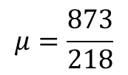
Practice
Jimmy is building a ride for his amusement park, JIMMY LAND. In this ride you slide down a ramp in a state of the art cardboard box. What does Jimmy need to make the coefficient of kinetic friction so that you slide down at a constant velocity?
m = 90 kg
Ff
N
N
Rotate
$$900∗\cos{φ}$$
Ff
$$φ$$
$$900∗\sin{φ}$$
W
W
$$φ=90−76=14$$
$$76°$$
X Y
$$F_{f}=900∗\cos{14}$$
$$N=900∗\sin{14}$$
F_{f} = 873 N
N = 218 N
$$μ=\frac{873}{218}$$
$$μ=4$$
$$μ∗218=873$$

Slide 16
Practice
Jane is a new employee of JIMMY LAND. She works at the box ride and it is her job to pull riders up the opposite side of the ramp so they can ride down. What is the force of Tension in the cord Jane uses to pull people up the ramp at a constant velocity?
N
T
N
Rotate
m = 90 kg
Ff
T
rough
$$φ$$
$$μ=4$$
Ff
$$W∗\cos{(8)}$$
$$82°$$
W
W
$$W∗\sin{(8)}$$
$$φ=90−82=8$$
X Y
$$F_{f}+W∗\cos\left(8\right)=T$$
$$N=W∗sin⁡(8)$$
$$μN+900∗\cos\left(8\right)=T$$
$$N=900∗sin⁡(8)$$
$$\left(4\right)\left(125\right)+891=T$$
$$N=125$$
N
$$T=1391$$
N

