Slide 1
Bell Ringer
1. What is the acceleration of these boxes?
2. Find the force of the 4kg block on the 2.3kg block and the force of the 2.3kg block on the 5.9kg block.
3. Now suppose there was a coefficient of friction of .14, how would this affect your answer to #2?
5.9kg
4kg
25N
2.3kg

Slide 2
Newton’s Third Law in Action
How much force is acting between the blocks?
24 kg
15 kg
12 N
7 kg
F1
F2
To solve this we first start by looking at the problem in a different light,
This is same as….
46 kg
All the blocks move together so they have the same acceleration and can be treated as the same object!!
12 N

Slide 3
46 kg
12 N
With the situation looking like this, we can easily apply Newton’s second Law
$$F_{net}=ma$$
$$12=46a$$
a = 0.26 m/s²
24 kg
15 kg
12 N
7 kg
F1
F2
F1
12 N
F2
F1
F2
$$12−F_{1}=15(0.26)$$
$$F_{1}−F_{2}=7(0.26)$$
$$F_{2}=24(0.26)$$
$$8.1−6.24=7(0.26)$$
$$F_{1}=8.1$$
$$1.8=1.8$$
$$F_{2}=6.24$$

Slide 4
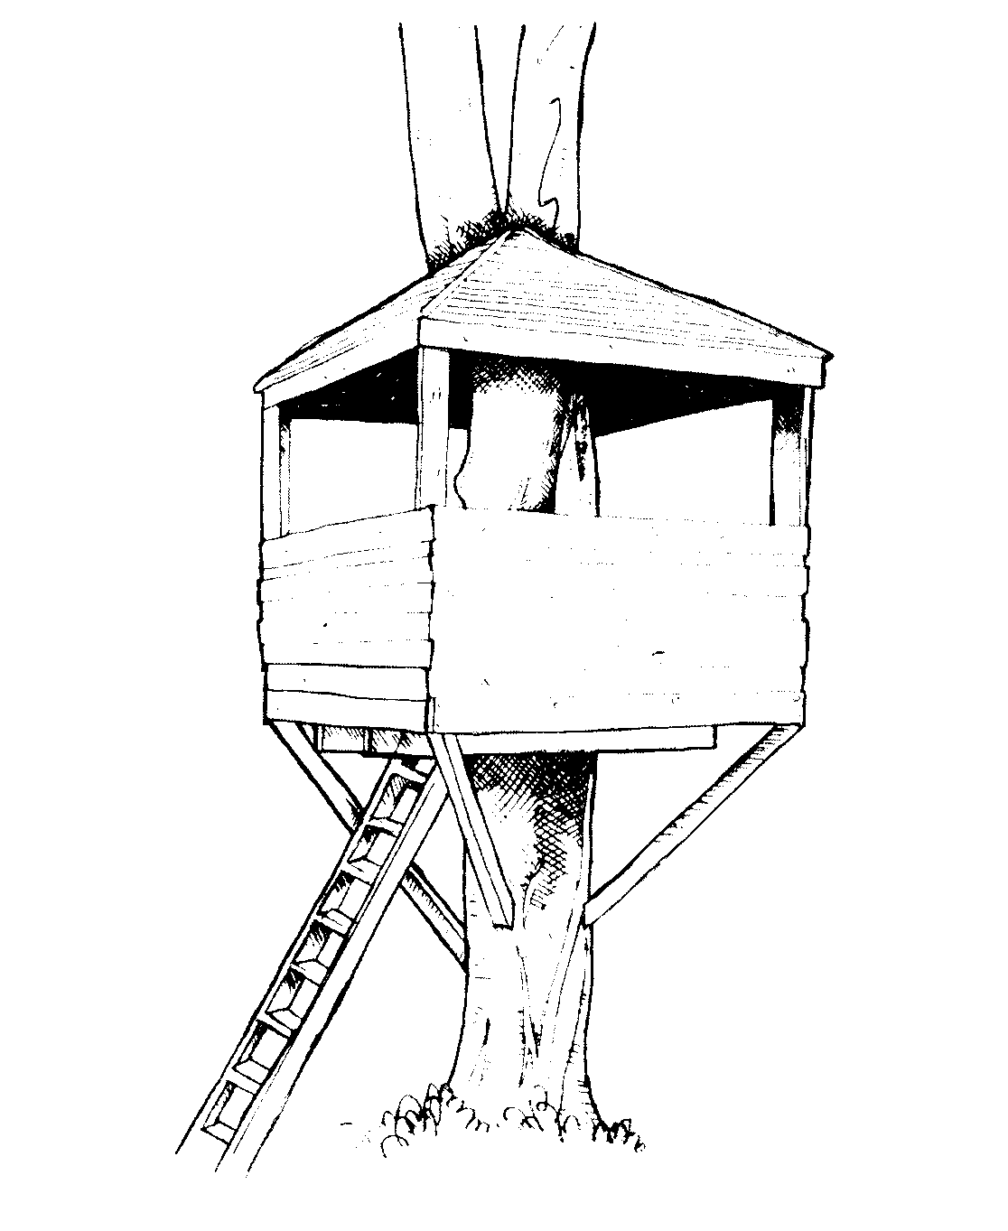
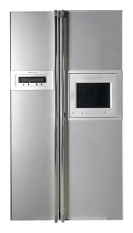
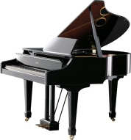
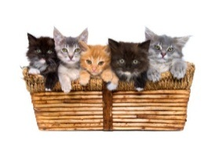
Practice
Jimmy is moving across town and is pushing his belongings down the frictionless street with a force of 125N. What is the force acting between each of the objects and the acceleration?
100 kg
120 kg
52 kg
F1
125 N
F2
F1
F2
125 = (272)a
a = 0.46 m/s²
$$125−F_{1}=100(0.46)$$
$$F_{1}−F_{2}=120(0.46)$$
$$F_{2}=52(0.46)$$
$$F_{1}=79$$
$$79−23.9=120(0.46)$$
$$F_{2}=23.9$$
$$55=55$$

Slide 5
https://www.youtube.com/watch?v=cP0Bb3WXJ_k

Slide 6
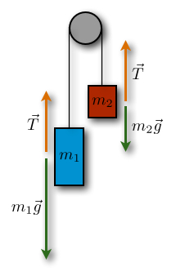
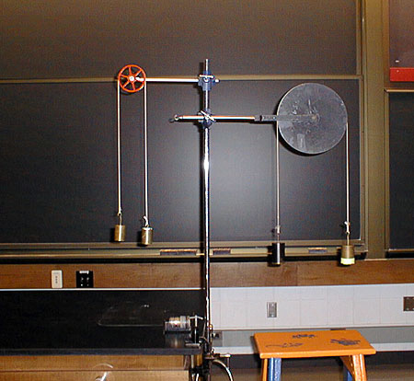
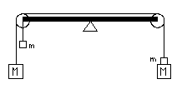
Atwood’s Machine

Slide 7
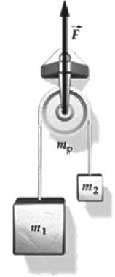
Imaginary Lab
If the difference in mass between the sides increases while the total mass remains the same, how does that affect the acceleration?
If the difference in mass remains constant, but the total mass increases, how does that affect the acceleration?
The acceleration of the system increases!!!
The acceleration decreases!!!!!!
WHY?
More mass means more inertia!!!!!

Slide 8
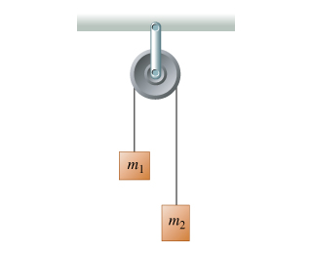
The Atwood’s Machine
How do we use Newton’s Second Law for a problem like this?
The purpose of any pulley is to change the direction of motion for a problem!!!!
What will be the acceleration of these 2 masses ?

Slide 9
The Atwood’s Machine
How do we use Newton’s Second Law for a problem like this?
How do we start any force problem?
T
T
W1
W2

Slide 10
The Atwood’s Machine
T
T
W1
W2
The competition between these two masses is like a game we sometimes play……
Looking at it like this and using the pulley the diagrams can be drawn this way:
W1
T
T
W2

Slide 11
W1
T
T
W2
What can you tell me about the two tensions?
They are the same!
m1 + m2
W1
W2
At this point we can apply Newton’s Second Law and solve
$$F_{net}=ma$$
Now for the equation will it be
W2-W1 = ma or W1-W2 = ma?
Why?

Slide 12
W1
T
T
W2
What can you tell me about the two tensions?
They are the same!
m1 + m2
W1
W2
If m1 is bigger W1 goes first.
If m2 is bigger W2 goes first.
$$F_{net}=ma$$
$$W_{2}−W_{1}=\left(m_{1}+m_{2}\right)a$$

Slide 13
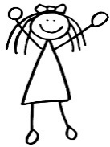
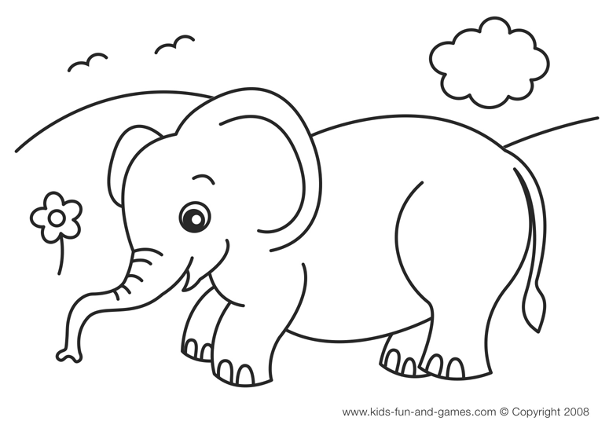
Jane is hiding out in her tree fort and needs to lift her pet elephant (231 kg) from the ground. She places a 500 kg mass in the opposite bucket and lets go. What is the net force that acts around the pulley?
$$F_{net}=W2−W1$$
$$W_{2}−W_{1}=5000−2310$$
$$F_{net}=2690 N$$

Slide 14
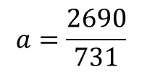
Jane is hiding out in her tree fort and needs to lift her pet elephant (231 kg) from the ground. She places a 500 kg mass in the opposite bucket and lets go. What is the acceleration of the elephant?
$$W_{2}−W_{1}=\left(m_{1}+m_{2}\right)a$$
5000 – 2310= (731) a
$$a=\frac{2690}{731}$$
a = 3.7 m/s²

Slide 15
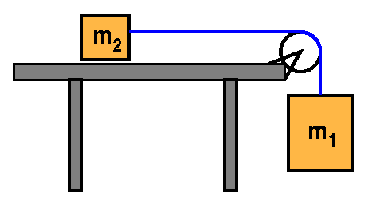
If m1 = 23 kg and m2 = 10 kg what is the acceleration of the system if µk = 0.5 ?
N
T
Line up the diagrams so the direction of motion is flat and the tensions match!
Ff
T
N
W2
Ff
T
T
W1
W1
$$F_{net}=ma$$
W2
$$W_{1}−F_{f}=\left(m_{1}+m_{2}\right)a$$
a = 5.5m/s²
$$W_{1}−μN=\left(m_{1}+m_{2}\right)a$$
$$230−\left(0.5\right)\left(100\right)=\left(23+10\right)a$$

Slide 16
Consider the two-body situation at the right. A 2.50x10³-kg crate (m₁) rests on an inclined plane and is connected by a cable to a 4.00x10³-kg mass (m₂). This second mass (m₂) is suspended over a pulley. The incline angle is 30.0° and the surface is frictionless. Determine the acceleration of the system and the tension in the cable.

