Slide 1
BELL RINGER
If I need to push something with a mass of 45kg at an acceleration of 5 m/s/s, what force would I have to apply?
If I have a force of 5N pulling right and a force of 12.4N pulling left, what is my net force?
What would be the object’s acceleration be for #2? (remember direction matters.)

Slide 2
Newton’s 2nd law review

Slide 3
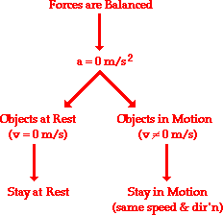
We’ve worked with balanced forces
Newton's first law of motion predicts object’s motion when all the forces on it are balanced.
If the forces are balanced, then the acceleration of that object will be 0 m/s/s.
Now we did have acceleration!!!
What affected/changed the acceleration of the objects?

Slide 4
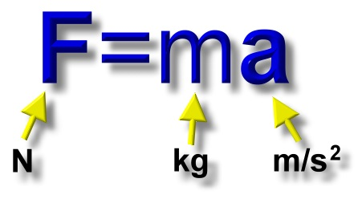
Newton’s Second Law

Slide 5
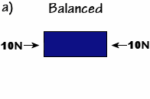
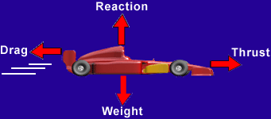
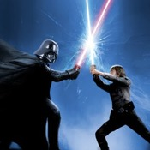
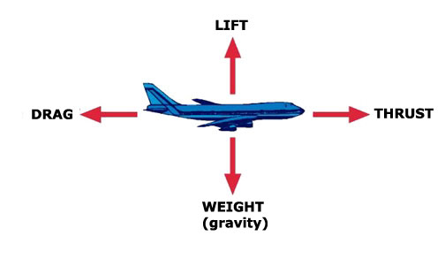

Slide 7
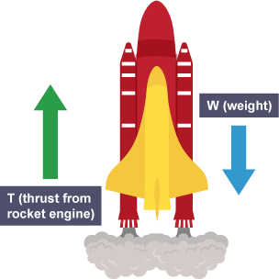
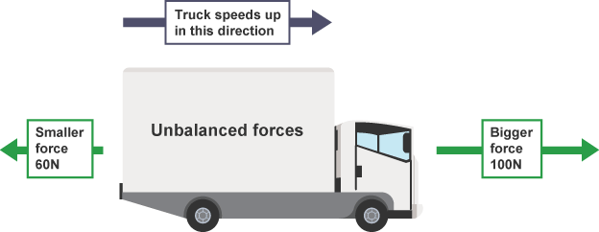
Unbalanced Forces
When forces are unbalanced then the acceleration will not be zero!
The velocity will change
300 N
100 N

Slide 8
Notes:
Emphasize why we could say it was 0. R-L = 0
When the net force is not = 0 then the forces are not balanced

Slide 9
Newton's second law of motion pertains to the behavior of objects for which the forces are unbalanced.
The second law states: the acceleration of an object is dependent upon two variables - the net force acting upon an object and the mass of the object.

Slide 10
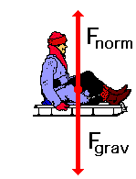
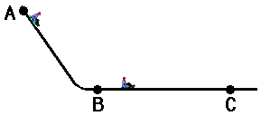
Imagine you are sledding down a hill
If there is no friction or air resistance…
What would its motion be like? How far would your sled travel?
All the forces are balanced and since the sled is already in motion at point B it will continue in motion with the same speed and direction.
So, what causes an object’s motion?
Forces do not cause motion
What causes an object to accelerate? What causes an object to change it’s motion?
Forces cause accelerations. They cause a change in motion.

Slide 11
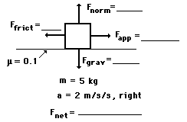
A rightward force is applied to a 5-kg object to move it across a rough surface with a rightward acceleration of 2 m/s/s. The coefficient of friction between the object and the surface is 0.1. Use the diagram to determine the gravitational force, normal force, applied force, frictional force, and net force. (Neglect air resistance.)

Slide 12
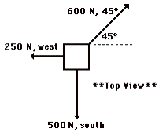
PRACTICE
Three people are fighting over the last can of pineapples in a store, according to the diagram at the right. In what direction will they all accelerate and by how much?

Slide 13
PRACTICE #2
Lon Mauer is cleaning up the driveway after mowing the grass. He exerts a sudden downward force of 56.8 N at a constant angle of 54.7° below the horizontal in order to accelerate his 1.05-kg broom from rest. The coefficient of friction between the broom bristles and the driveway is 0.567. Determine the rate of acceleration of the broom. (Suggestion: Begin with a free body diagram.)

Slide 14
Determine the following quantities for a car driving on a level surface with a coefficient of static friction of 0.75 (¾) and a coefficient of kinetic friction of 0.67 (⅔).Determine the car's maximum starting acceleration with and without "burning rubber". How do these two methods of starting a car compare?
Determine the car's minimum braking distance with normal brakes and antilock brakes as a function of initial speed. How do these two methods of stopping a car compare?

