Slide 1
Bell Ringer
If I weigh 76N on Earth, what is my mass?
What would be my weight on the Moon? (gM=1/6gE)
If I weigh 76N on the Moon what is my mass?
What would be my weight on Earth?

Slide 2
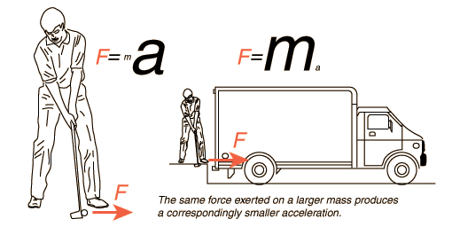
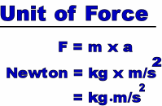
Newton’s Second Law

Slide 3
From the Lab
Last time in the lab we learned that the relationship between force and motion is:
$$F_{net}=m∗a$$
What does this mean?
Directly Proportional
The relationship between force and mass :
The relationship between acceleration and mass :
Inversely Proportional

Slide 4
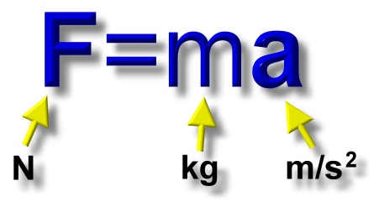
Newton's second law of motion
$$F_{net}=m∗a$$
The second law states: the acceleration of an object depends on two variables - the net force acting upon an object and the mass of the object.

Slide 5
This law may be a more easily understood if we look at it in a different form.
If we divide both sides of our equation
F=ma
by “m” we get this

Slide 6
The second law states: the acceleration of an object is dependent upon two variables - the net force acting upon an object and the mass of the object.
Notes:
Emphasize why we could say it was 0. R-L = 0
When the net force is not = 0 then the forces are not balanced

Slide 7
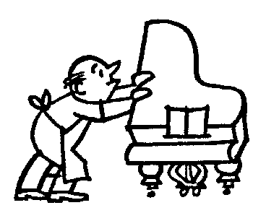
The Concept of Newton’s 2nd Law
Take a look at the following situations and apply the ideas conveyed by Newton’s 2nd Law:
If the acceleration of the piano is 3 m/s^2
How would it change if 4 people pushed?
12 m/s^2
If the piano were switched out for a cardboard box and the man did not change his pushing force, how would that affect the acceleration?
The acceleration would increase!!!

Slide 8
The acceleration of an object depends:
-directly upon the net force on an object,
-and inversely upon the mass of the object
 | NET FORCE | MASS | ACCELERATION
1 | 10 | 2 | 5
2 | 20 | 2 | 10
3 | 40 | 2 | 20
4 | 100 | 5 | 20
5 | 100 | 10 | 10
6 | 100 | 20 | 5

Slide 9
Say a golf ball has a mass of .05 kg and a truck has a mass of 5,000 kg.
If you hit a golf ball with 100 N and the truck with 100 N of force what would happen?
How much would you be able to accelerate the golf ball at?
How much would you be able to accelerate the truck at?

Slide 10
How much more force would you have to exert on the truck to get it to accelerate like the golf ball?
10,000,000 N of Force!!!
10 Million!

Slide 11
If you are in a car and you are able to accelerate at 5m/s, then if more people get in the car, what will be it’s new acceleration?
Will it be bigger or smaller?
Blobby – Hotel Transylvania
https://www.youtube.com/watch?v=-QfDJbiumhM
Rocket sled

Slide 12
In order for an acceleration to occur, we need a net force that does not = O
We need to change the way we think about calculating the force acting on an object.
$$F_{net}=m∗a$$
The forces will not always be balanced!!!

Slide 13
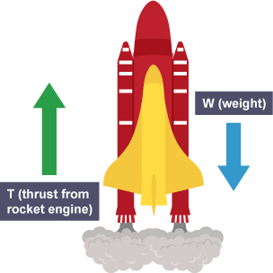
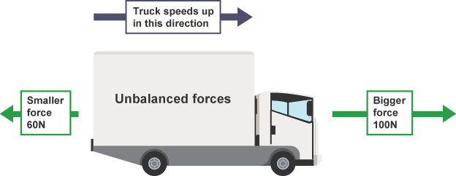
Unbalanced Forces
When forces are unbalanced then the acceleration will not be zero!
The velocity will change
300 N
100 N

Slide 14
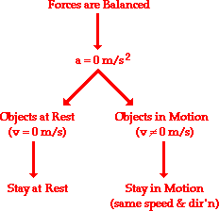
We’ve worked with balanced forces
Newton's first law of motion predicts object’s motion when all the forces on it are balanced.
Now we will have acceleration!!!
What affects of changes the acceleration of the objects?

Slide 15
The steps we follow for Force problems
Step 1: Draw our force diagram
Step 2: Find the net Force in the x direction.
Step 3: Find the net force in the y direction.
Step 4: If the net force is zero, write a balanced force equation.
Step 5: If the net force is not 0 use F=ma to solve!

Slide 16
Net Force
$$F_{net}=m∗a$$
N
Not balanced
X
Rforce – Lforce = Net X force
Ff
Fp
Fp – Ff = Fnet-x
Balanced
Y
W
Uforce – Dforce = Net Y force
N – W = ZERO
rough

Slide 17
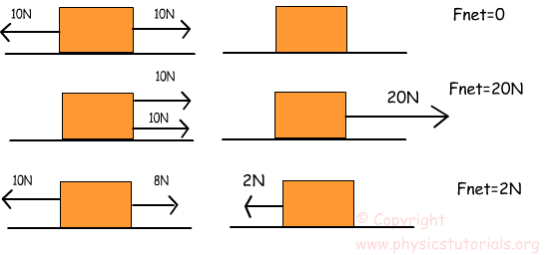
Net Force
$$F_{net}=m∗a$$
Practice problem 3 and 4

Slide 18
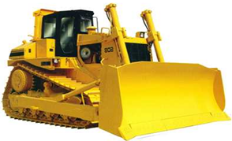
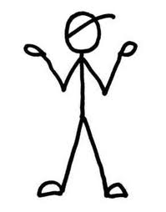
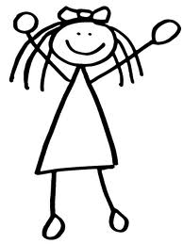
Application of 2nd Law
zzzzz
1200 kg
Jimmy caught Jane sleeping on the job…… so he has decided to push his bulldozer over her. Jimmy pushes the dozer with a force of 2500N. If the coefficient of kinetic friction is 0.2, what is the acceleration of the dozer?
N
$$F_{p}−F_{f}=ma_{x}$$
If Jane is 32 m away from the dozer, how long does she have to wake up?
Fp
$$2500−μN=ma_{x}$$
Ff
$$2500−\left(0.2\right)\left(12000\right)=\left(1200\right)a$$
W
a = 0.083 m/s²
t = 27.76s

Slide 19
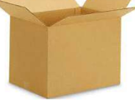
Practice
Jimmy has decided to make some changes to his box/ramp ride. To give it more of a thrill, he has used bacon grease to reduce the friction on the surface to zero. What is the acceleration of the riders as they speed toward the bottom of the hill?
N
N
m = 90 kg
Rotate
$$900∗\cos{φ}$$
$$φ$$
$$900∗\sin{φ}$$
W
$$φ=90−65=25$$
W
$$65°$$
X Y
$$900∗\cos{25}=ma_{x}$$
$$N=900∗\sin{25}$$
$$815.6=(90)a_{x}$$
$$N=380.3$$
$$a_{x}=\frac{815.6}{90}$$
$$a_{x}=9.06m/s^{2}$$

Slide 20
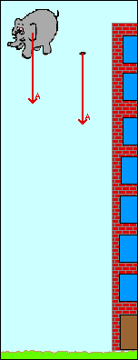
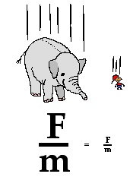
Why do all objects fall at the same rate?
F=ma
or
a=F/m
What is the Fg for the elephant compared to the mouse?

